Slide 1
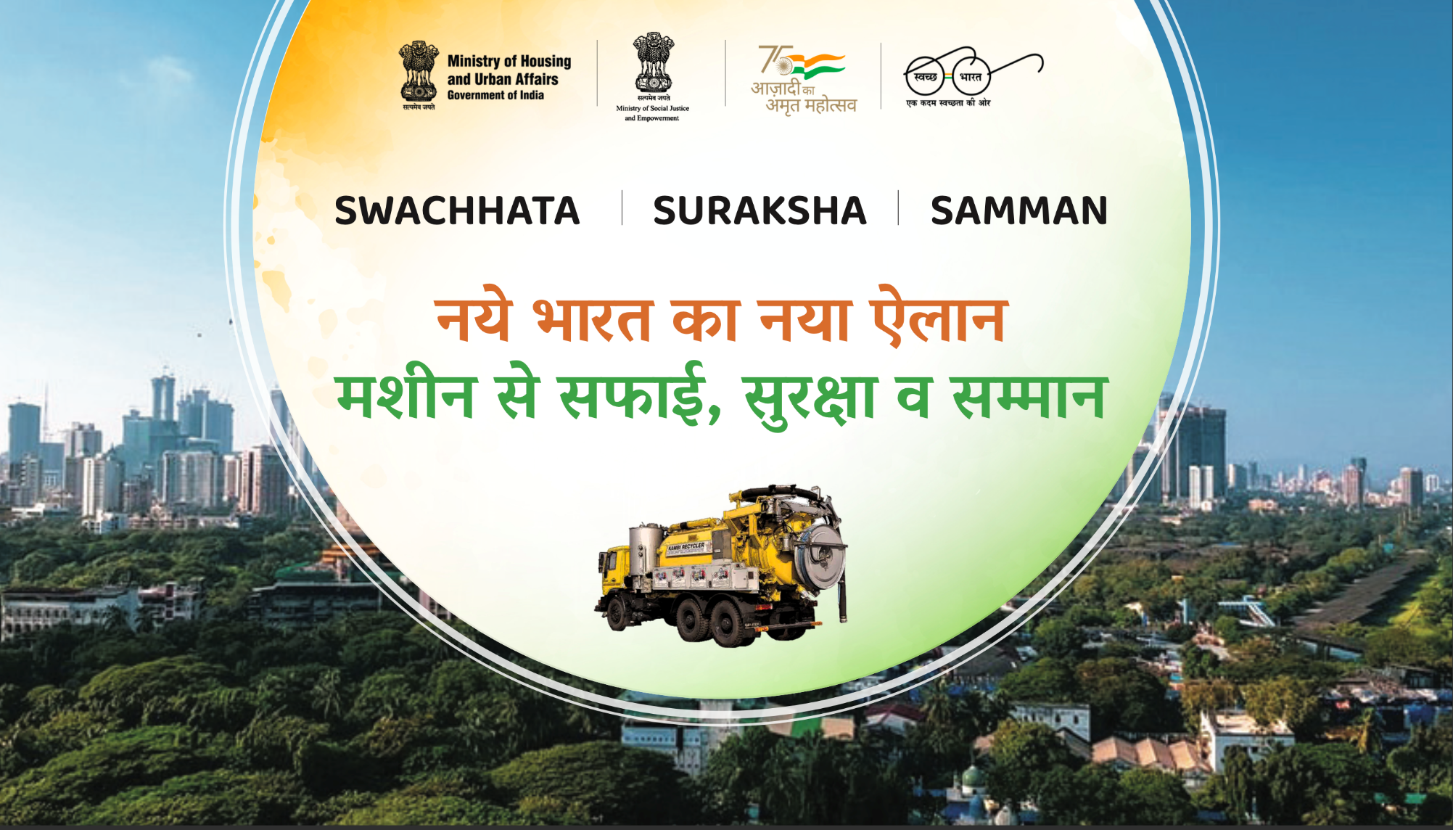
Presentation by Sector Organizations

Slide 2
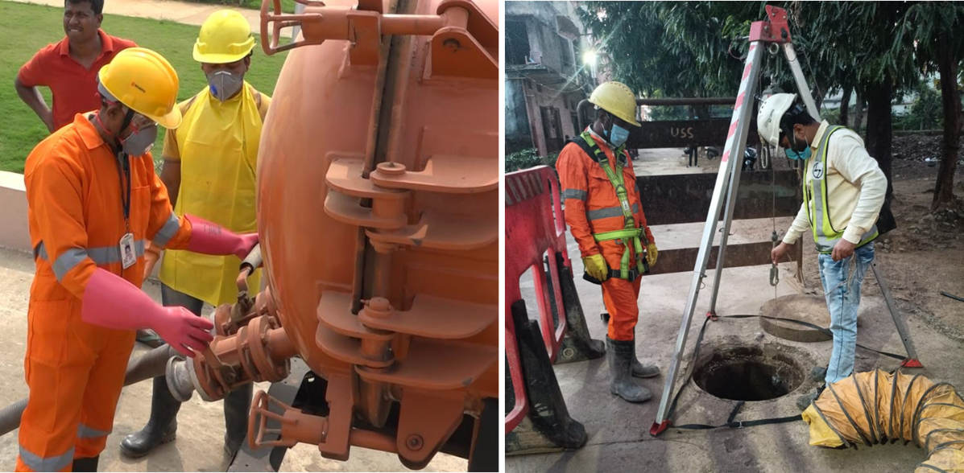

NAMASTE
National Action for Mechanized Sanitation Ecosystem-
for
Safety and Dignity of Sewer/Septic Tank Workers (SSWs)
In Urban India
Presentation by

Slide 3
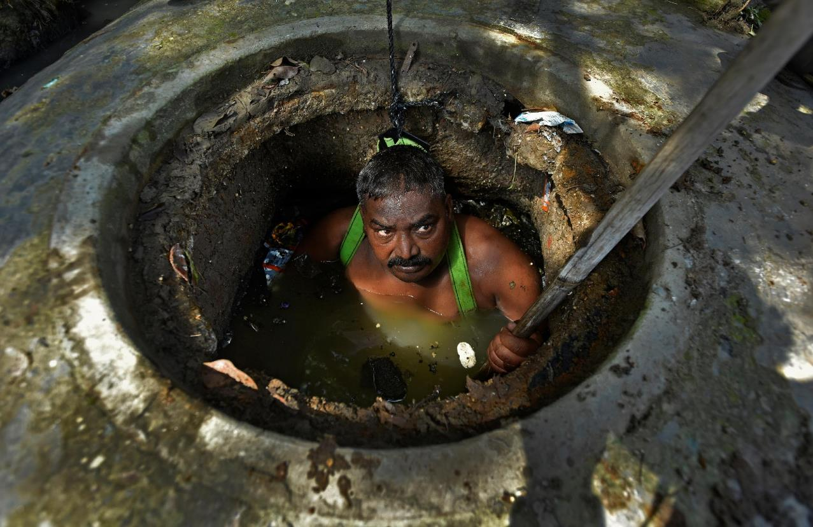
Intergenerationality in Sanitation Work
More than 50% of workers do this work as they could not get any other work
3/4th women are engaged in sanitation sector as they married to or born in sanitation worker’s family
XX% educated but continue doing this work
“
Most of us have inherited this work from our fathers and their ancestors, but I don’t want my children to do this work. I want them to study and chose a different profession.
”

Slide 4
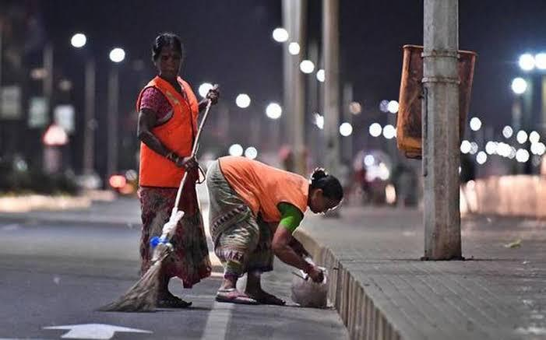
Informality in Sanitation Work
Highest informality in septic tank cleaning
No access to social and financial safety net
90% of all workers do not have any insurance cover
Insurance coverage for female workers is almost half that of male workers
All informal workers lack insurance cover
“
I work with no effective layer of protection, because everything is designed for men.
”

Slide 5
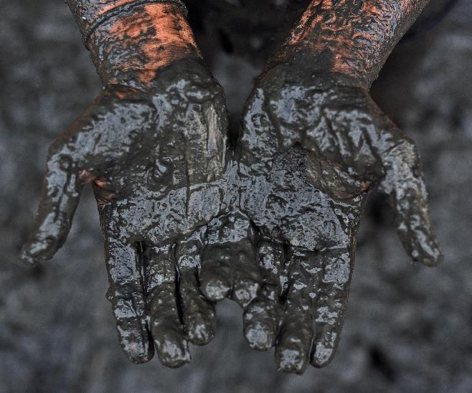

Access to PPE during Covid-19 pandemic
“
We clean with bare hands. We find all sort of stuff inside these drains- broken glass, blades, sanitary pads and even animal carcasses. We contract skin and respiratory diseases and live 10-15 years lesser than others.
”
Source: Health, Safety and Livelihoods Challenges of Sanitation Workers in COVID-19, WaterAid and UMC (2020)

Slide 6
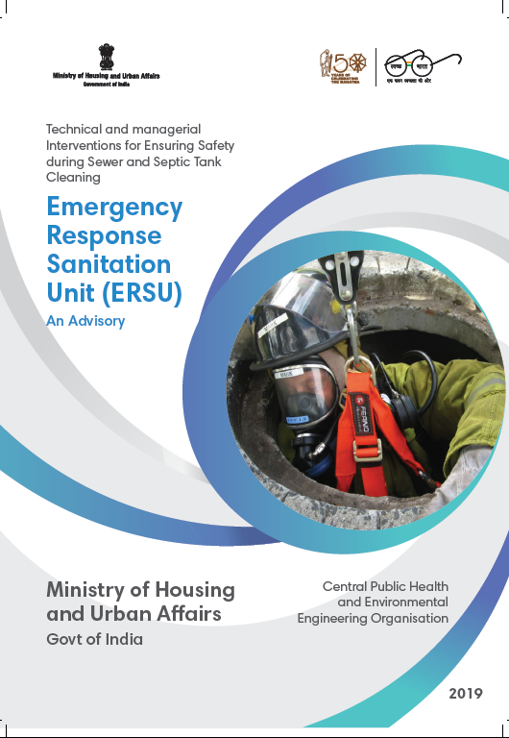

Why NAMASTE?

Slide 7
Enhancing their occupational safety by capacity building and improved access to safety gear and machines
Access to alternative livelihoods support and entitlements to break the intergenerationality in sanitation work.
Bring about a behaviour change amongst citizens towards sanitation workers and enhance demand for safe sanitation services
Goal
The goal of NAMASTE Action Plan is to ensure safety and dignity of sanitation workers in urban India
Salient features
Visibilising the workers, especially working informally for cleaning of septic tanks and sewer lines
City wide approach, through a granular survey of sanitation workers, for ensuring occupational safety

Slide 8
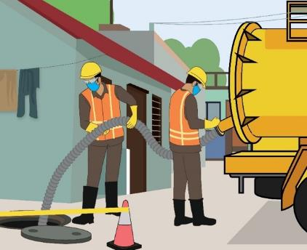
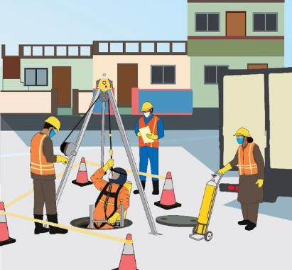
Key beneficiaries
All Sewer and septic tank Sanitation Workers (SSWs) directly dealing with faecal matter, in urban areas
Involved in the following sanitation works:
Emptying of septic tank
Sewerage network maintenance
Emptying of septic tank
Sewerage network maintenance

Slide 9
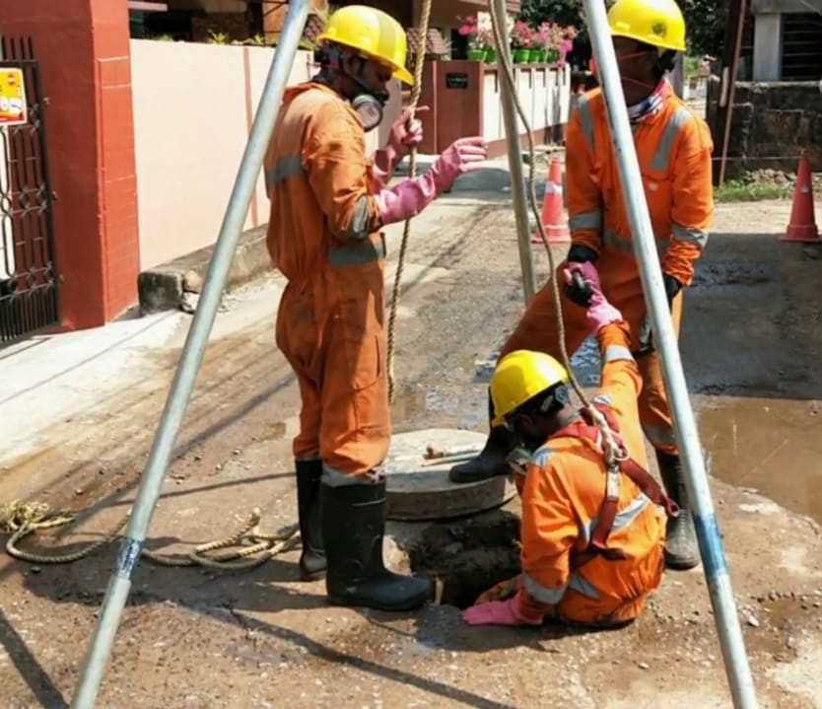
Intended Outcomes
Zero fatalities in sanitation work in India
All sanitation work is performed by skilled workers
No sanitation workers come in direct contact with human faecal matter
Sanitation workers are collectivized into SHGs and are empowered to run sanitation enterprises
All Sewer and Septic tank sanitation workers (SSWs) have access to alternative livelihoods
Strengthened supervisory and monitoring systems at national, state and ULB levels to ensure enforcement and monitoring of safe sanitation work
Increased awareness amongst sanitation services seekers (individuals and institutions) to seek services from registered and skilled sanitation workers

Slide 10
Why NAMASTE?

Slide 11
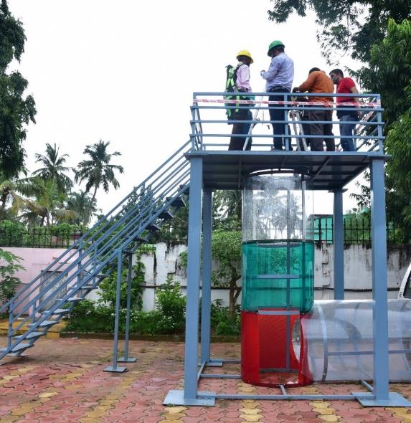
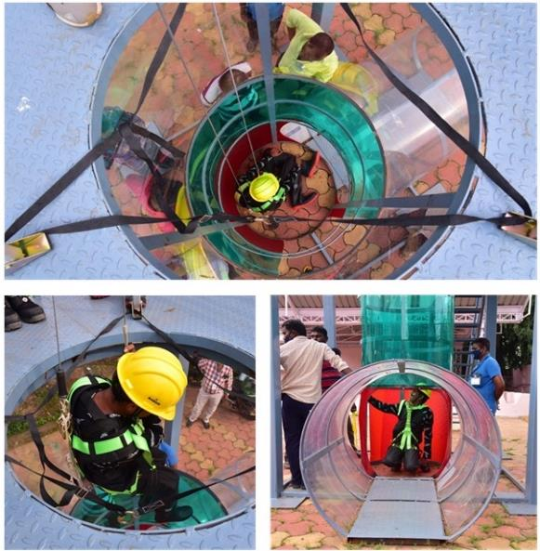
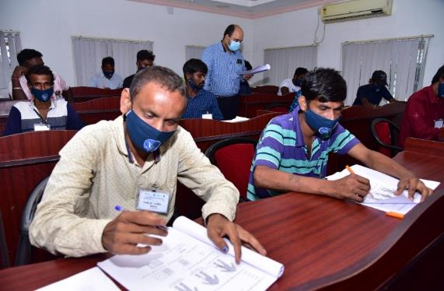
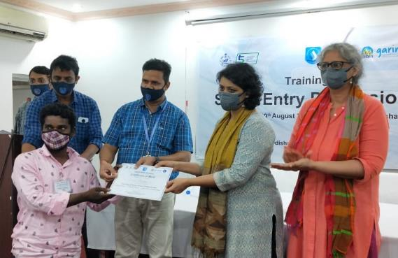
Training ecosystem for skilling of core sanitation workers
Institutionalization of training on occupational safety
Interactive pedagogy, both theory and practical, pre- and post-training assessment, certification

Slide 12
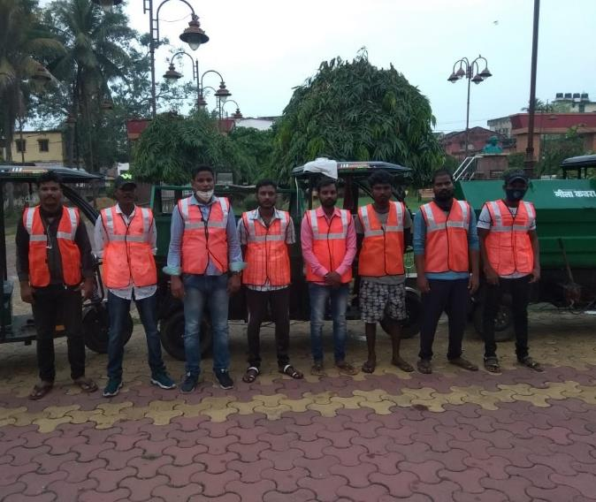
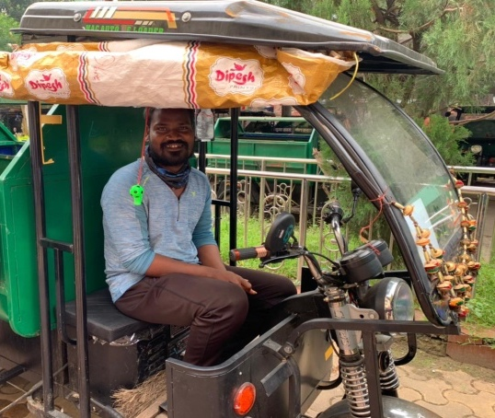
Federation into SHG
Federating them into self help groups
~1600 SHGs of sanitation workers nationally
Easy access to benefits for socials schemes
Start an enterprise through financial support from the Govt.
Similar approach of ‘SVANidhi se Samriddhi’ to setup camps

Slide 13
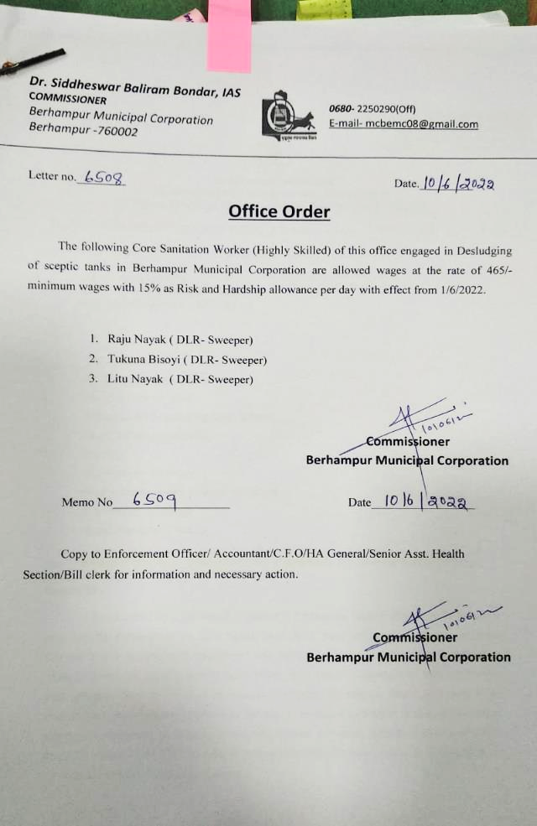
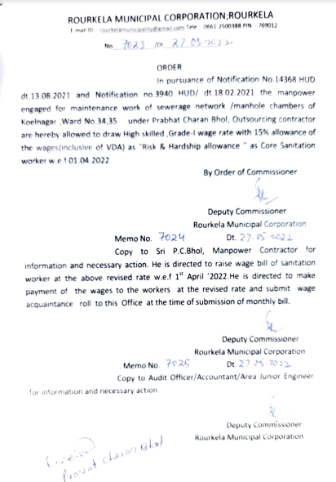
Recognition as Skilled Labour for Enhanced Wages and Hardship Allowance
Salary as per unskilled category
No any other benefits or allowances given
In Odisha under Garima scheme
  Identified as highly skilled workers
  Getting certified training
  Min. wages are revised
  Given 15% risk and hardship allowance

Slide 14
Minimum wages for sanitation workers in other states
 | State | Category in the schedule list of employments | Skill category | Min daily wage as per the latest notification (in Municipal corporations)
1 | UP | Not listed (sweeping and cleaning, not including manual scavengers) | Not specified | ₹ 349
2 | Telangana | Safai Karamcharis Sewerage, Soil, Bath Room and Latrines and other similar type of work as Labourers | Not specified | ₹ 431
3 | Andhra Pradesh | Safai Karamcharis Sewerage, Soil, Bath Room and Latrines and other similar type of work as Labourers | Not specified | ₹ 408.16
4 | Tamil Nadu | Sweeper, Employment in local authority | Not specified | ₹ 375.77
5 | Maharashtra | Sweeper and scavenger | Not specified | ₹ 370.43
Notes:
https://drive.google.com/file/d/1zda9bxPBMUCldlUGuUrAvzJvYmkc1dyC/view
https://labour.telangana.gov.in/minimumWages.do
https://paycheck.in/salary/minimumwages/13970-andhra-pradesh/36005-safai-karmacharis
https://www.simpliance.in/minimum-wages/tamil-nadu
https://www.simpliance.in/minimum-wages/Maharashtra

Slide 15
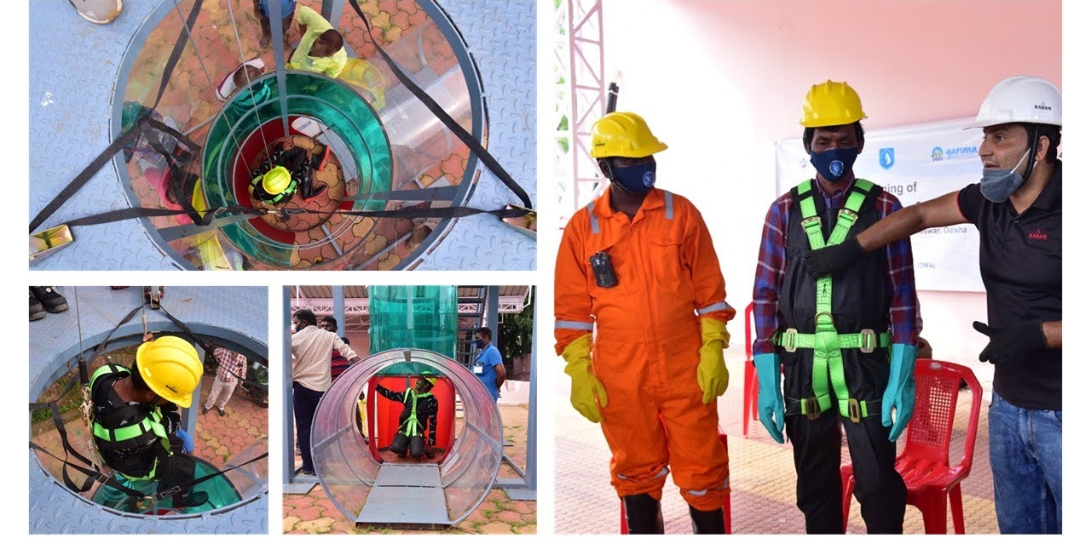
Thank You
For more details, contact:
Manvita Baradi (manvita@umcasia.org), Director
Meghna Malhotra (meghna@umcasia.org), Deputy Director
Website: www.umcasia.org | YouTube: https://www.youtube.com/c/UrbanManagementCentre

