Slide 1
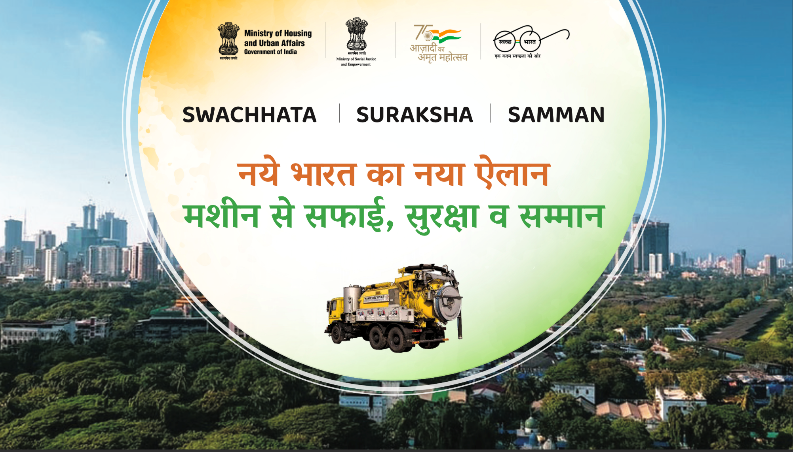

Slide 2
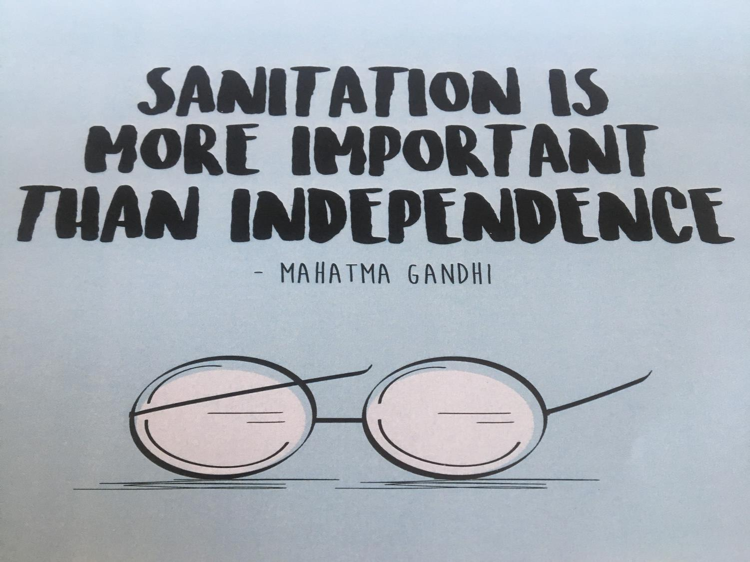

Slide 3
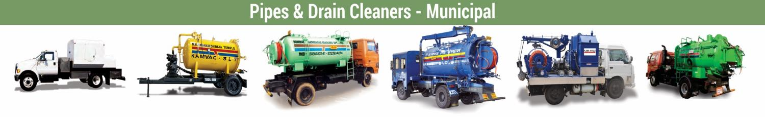
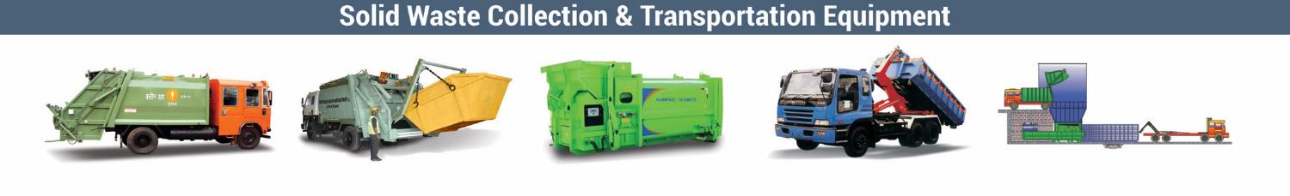
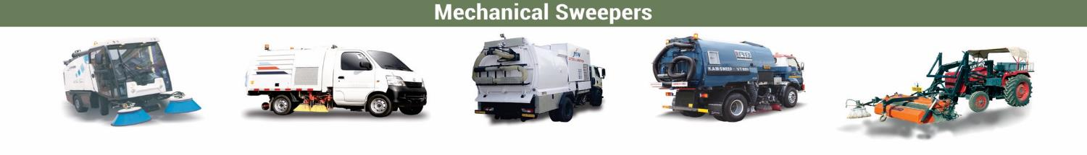
WHO WE ARE
We are a group of like-minded professionals, who came together, two decades ago, to challenge the dehumanizing practice of manual scavenging through mechanization.

Slide 4

It’s from this understanding and conviction that we have incorporated
A Section 8 Social Enterprise

Slide 5

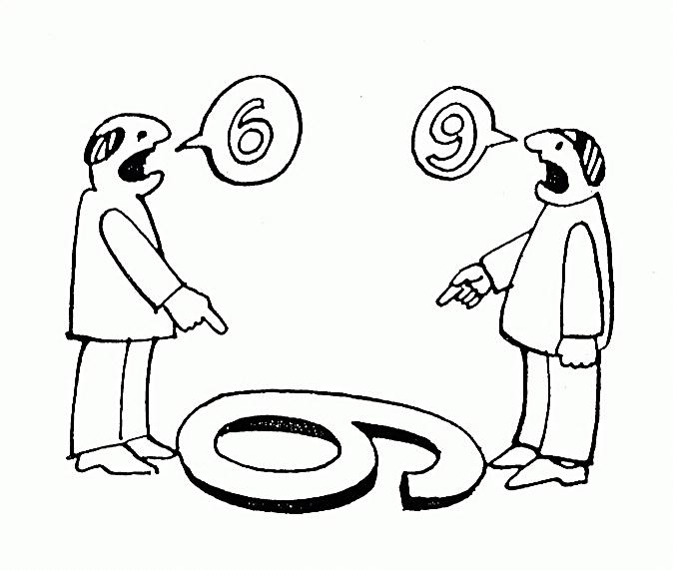
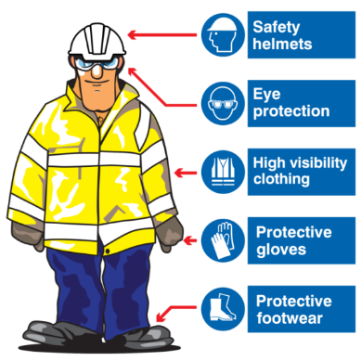

WHAT WE DO
Change of Perception of self & occupation!!
4P
Perception
Prohibition
Profession
Protection
Leveraging their domain knowledge / skill set for a better sustainable livelihood !!
Use of PPE and safety devices to protect oneself from occupational health hazard !!
Awareness as regards the PRMS ACT 2013 & redefining their role and responsibility !!

Slide 6
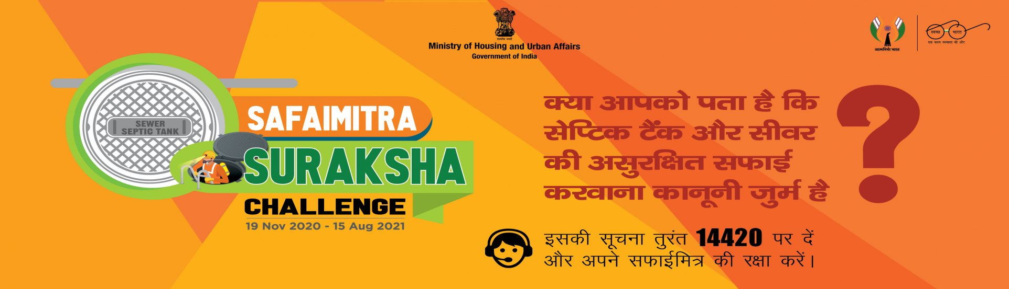
Safai Mitra Suraksha Challenge

Slide 7
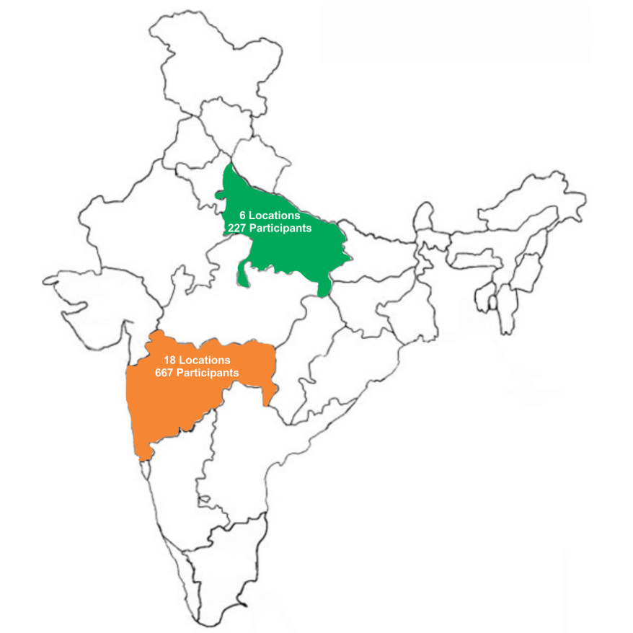
State wide distribution of participants
SAFAI MITRA SURKSHA CHALLENGE
CITY | No of Participants
Maharashtra
Pune Mun. Corporation | 24
Pimpri-Chinchwad Mun.Corpn. | 7
Municipal Corporation of Greater mumbai | 36
Mira Bhyander Mun.Corpn. | 23
Malegaon Mun.Corporation | 20
Nanded Waghela Mun. Corporation | 68
Jalgaon Muni.Corporation | 7
Amaravati Muni.Corporation | 41
Chandrapur Muni.Corporation | 58
Ahmadnagar Muni. Corporation | 15
Sangli Muni. Corporation | 27
Latur municipal Corporation | 27
Parbhani Muni.Corporation | 22
Panvel Muni. Corporation | 33
Navi Mumbai Municipal Corporation | 50
Aurangabad Muni.Corpotation | 109
Kolhapur Muni.Corpotation | 50
Dhule Muni.Corpotation | 50
Total | 667
Uttar Pradesh
SAHARANPUR | 51
MATHURA | 48
BARREILLY | 42
SAHAJHANPUR | 30
PRAYAG (ALLAHABAD) | 21
GORAKHPUR | 25
Total | 217
Total | 217

Slide 8
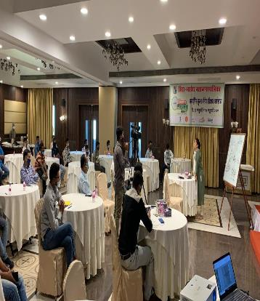
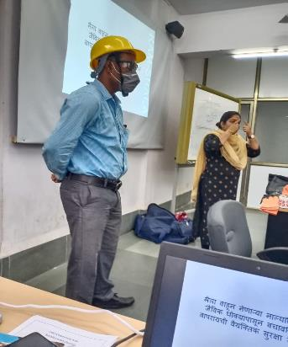
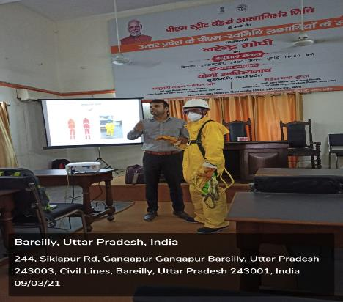
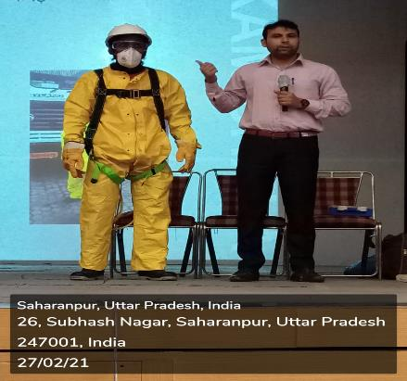
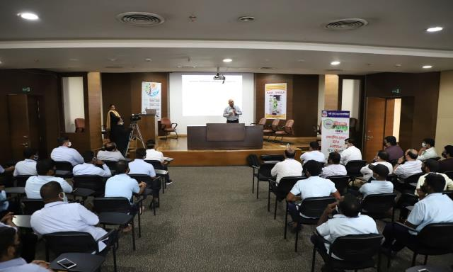
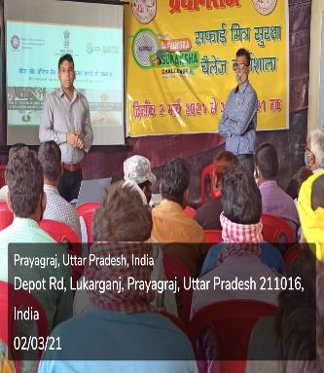
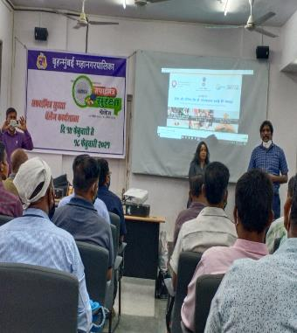
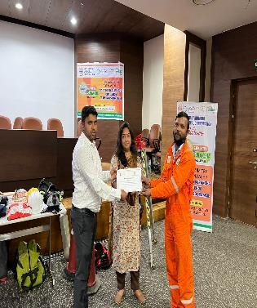
Classroom Sessions under Safai Mitra Suraksha Challenge

Slide 9
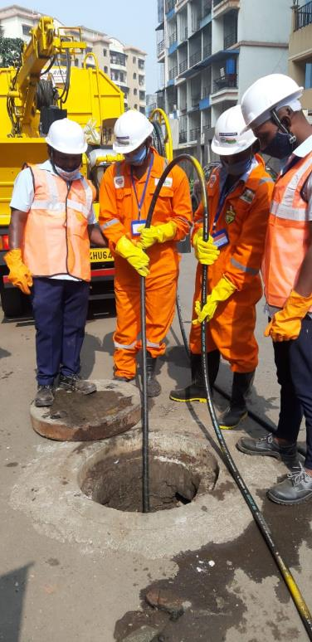
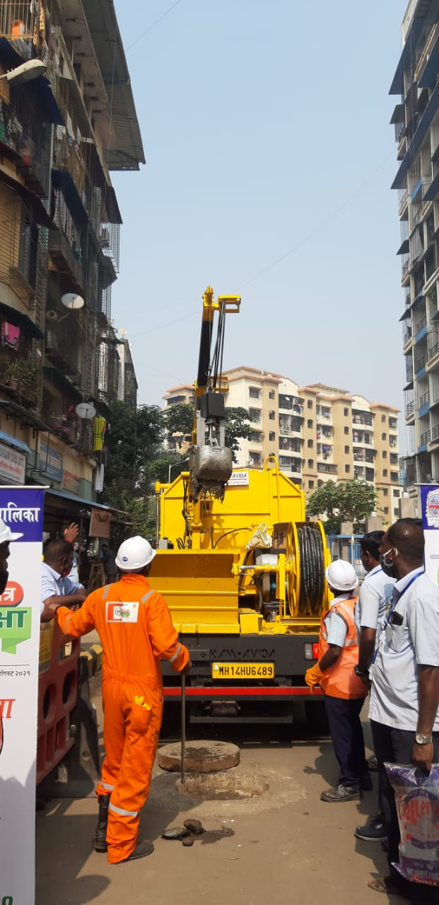
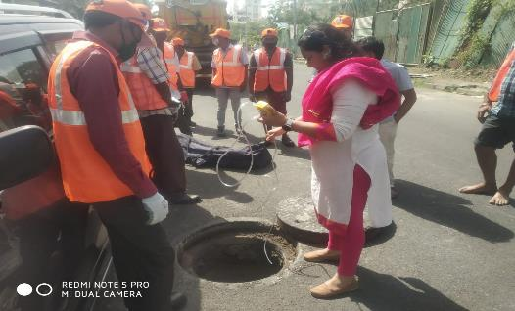
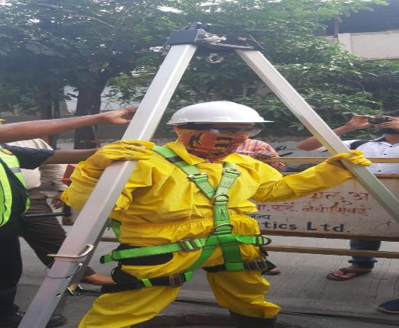
Practical Sessions under Safai Mitra Suraksha Challenge

Slide 10
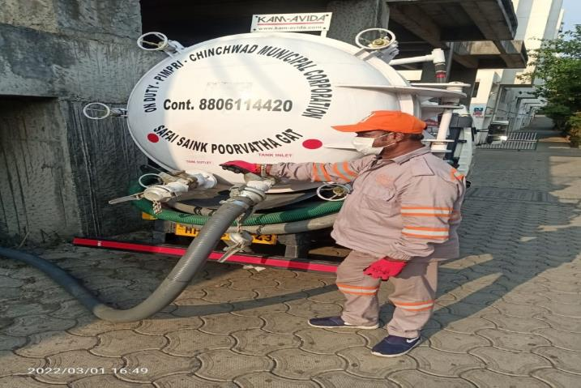
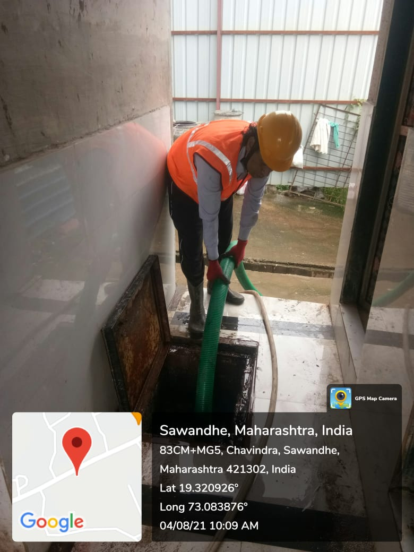
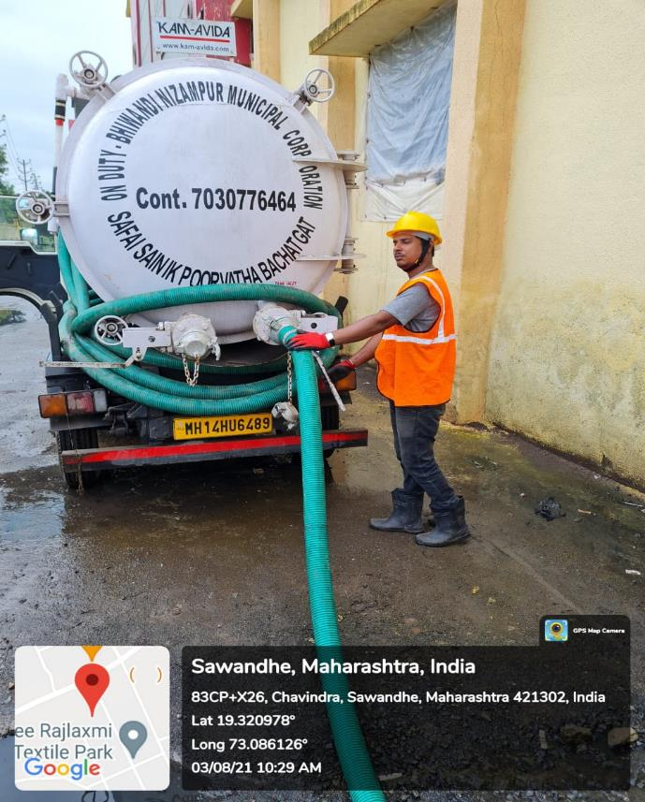
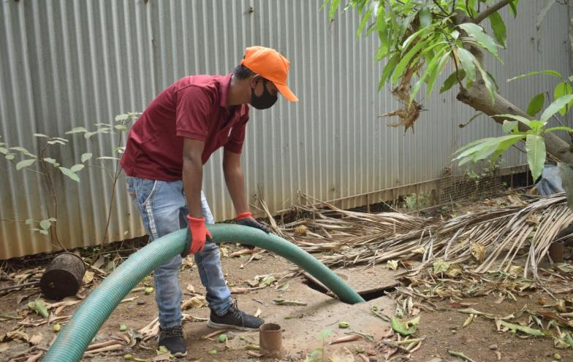
Use of unique domain knowledge for sustainable livelihood

Slide 11
SANITATION SOLDIERS

