Slide 1
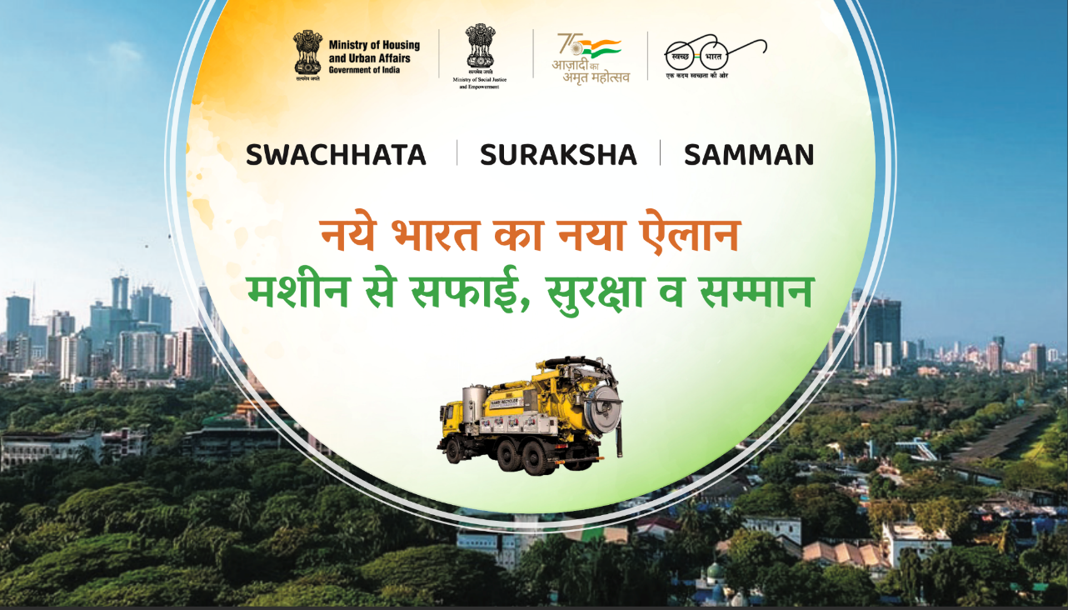
Hoarding

Slide 2
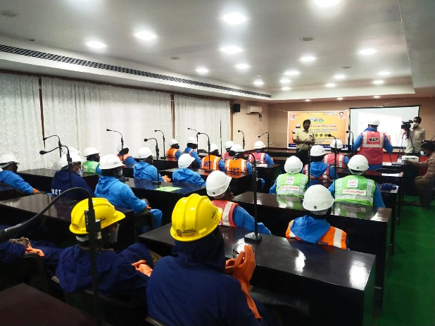




IN TIRUPATI
Tirupati Municipal Corporation
Mrs. Dr. B R SIRISHA
MAYOR
Ms. ANUPAMA ANJALI, I A S
COMMISSIONER

Slide 3
CITY
PROFILE
Tirupati Municipal Corporation is the largest Urban Local Body (ULB) in the district of Tirupati in Andhra Pradesh.
It is spread over 27.44 sq. kms with a population of about 2,87,482 as per 2011 census. The Present population is about 4,24,286 ( 104057 Households).
⧫ Established 352 Km extensive Sewerage network
⧫ 13720 Manholes
⧫ 96 Members Safaimitra Wrokers
TIRUPATI MUNICIPAL CORPORATION

Slide 4
JOURNEY OF THE ULB
⧫ Before SafaiMitra Suraksha Challenge, Tirupati had sewerage network that covers nearly 60% of properties.
⧫ With the Challenge we took in 2020,Tirupati established 90% sewerage network, strengthened sewer cleaning infrastructure and achieved “manhole to machine-hole” transformation by January 2021.
⧫ The Corporation procured 5 Jetting & Suction Machines, 9 Desludging vehicles, 12 power rodding and 12 desilting machines and provided livelihood to the manual scavengers in a bid to do away with hazardous manual sewer entry.
⧫ The revenue streams like Sewerage charges and sale of treated STP water covers entire O&M costs.
⧫ A group of 96 members drawn from the families of Safai karamcharis and equipped them with professional training to deal with the UGD network maintenance.
⧫ Tirupati provided extended benefits to its sanitation staff including informal and contractual workers along with permanent staff to support their safety & well-being.

Slide 5
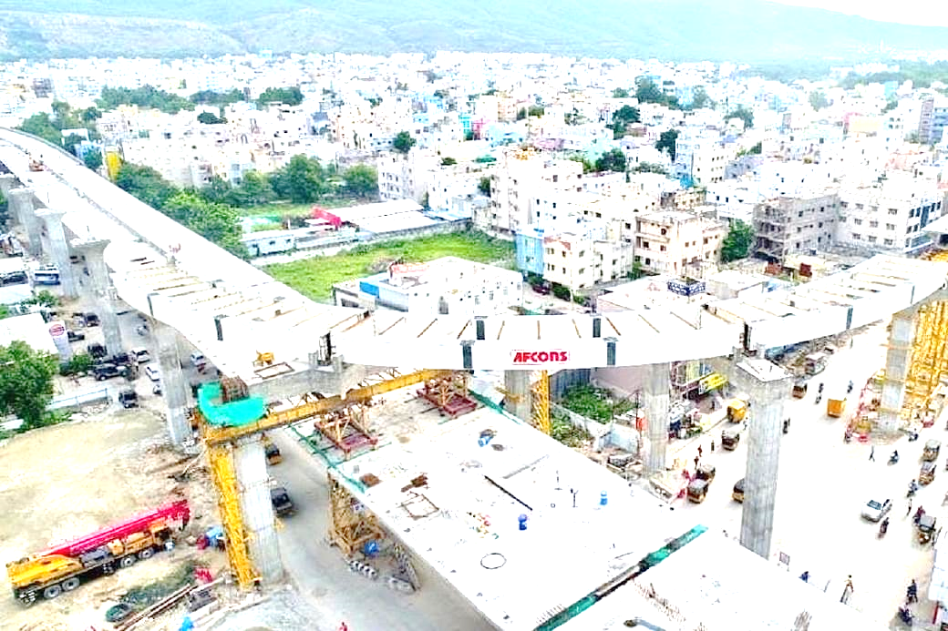

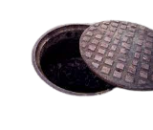

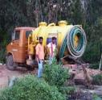


THE CITY - BEFORE 2020 ( SSC)
THE CITY - AFTER 2020 ( SSC)
8500 MANHOLES
Established extensive sewerage network and connections (>90%)
13720 Manholes
Identified, trained informal workers and integrated into formal sanitation system
Empanelled, trained and issued licenses to the private desludging operators
Procured and strengthened Sewer cleaning fleet under Tirupati Smart city corporation Funds
Introduced ICT based vehicle tracking mechanism
constituted - Emergency Sanitation Response Unit (ESRU) – with 20 members well trained “Sewer entry professionals” & “inspection commandos” / Sanitation Response Unit (SRU) & Responsible Sanitation Authority (RSA)
60 % SEWERAGE NETWORK
INFORMAL , MANUAL ENTRY INTO SEWERS
INFORMAL SEPTIC TANKS – DESLUDGING SYSTEM IN OPERATION
FAIRLY STRENGTHEND SEWER CLEANING & DESLUDGING FLEET
STP-FSTP
CO-TREATMENT FACILITY

Slide 6
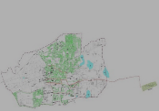
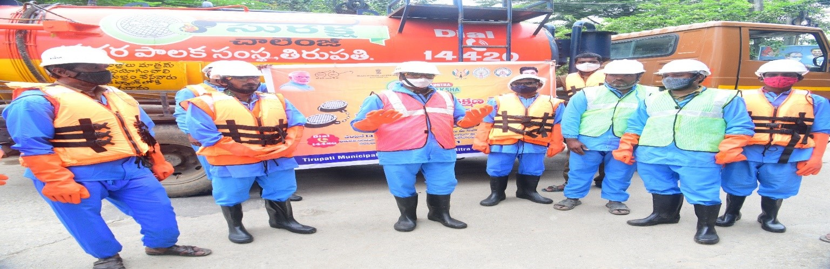
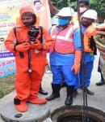


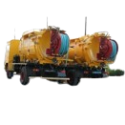
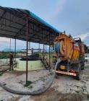



  Tirupati Municipal Corporation had constituted the Emergency Sanitation Response Unit (ESRU) – with 20 members well trained “Sewer entry professionals” & “inspection commandos” / Sanitation Response Unit (SRU) & Responsible Sanitation Authority (RSA) under Municipal Commissioner (Magistrate)
  Established extensive sewerage network and connections (>90%)
  Identified, trained informal workers and integrated into formal sanitation system
THE CITY – WITH SAFAIMITRA SURAKSHA CHALLENGE
  Procured, distributed - PPE and safety gear & trained waterborne sanitation staff
  Empanelled, trained and issued licenses to the private desludging operators. Installed/ fitted GPS based tracking devices in all the vehicles for efficient management of the sewer cleaning and maintenance fleet.
  Procured and strengthened Sewer cleaning fleet under Tirupati Smart city corporation Funds
Introduced ICT based vehicle tracking mechanism
Empanelled Sulabh international for the maintenance of Community and public toilets in the city
Engaged Self-help Groups – maintain urinal blocks

Slide 7
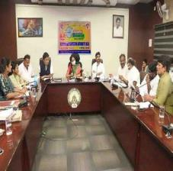
SYSTEM & INFRASTRUCTURE ( PROCUREMENT INFORMATION)
MACHINERY
Jetting and Suction Vehicles 5
Desludging Vehicles 9
Sewer Inspection Camera Apparatus 1
Power Bucket Machines 2
Hydraulic Sewer Root cutters 2
Power Rodding Apparatus 12
RSA & SRU
MACHINERY/ EQUIPMENT
SAFETY GEAR & PPE
TRAINING & CAPACITY BUILDING
BENEFITS TO THE SANITATION STAFF
SAFETY GEAR
Safety Tripod Set 1
Nylon Rope Ladder 2
Blower with Air Compressor 1
Gas Monitor (4 Gases) 1
Full Body Wader Suit 2
Gas Mask 3
Breathing Apparatus 1
Safety Body Harness 2
Airline Breathing Apparatus 1

Slide 8
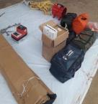
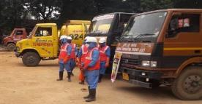
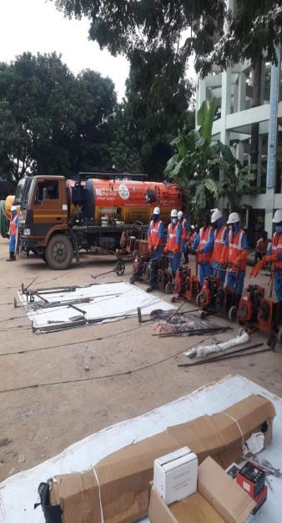
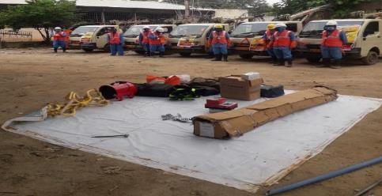

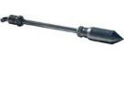
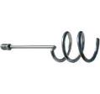
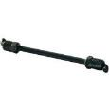
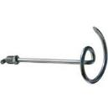
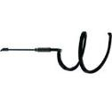
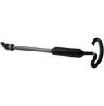
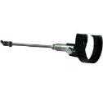
VARIOUS MACHINERY PROCURED AND TOOLS USED IN RODDING SEWERS IN THE CITY
Root cutter
Root Saw
Penetrates the toughest obstructions faster than any other plug buster
Bullet Tool
Useful in retrieving rags and opening small pipe blockages. The corkscrew can also be used for pulling sections of rod or rodding tools from a line if they break or come apart.
Used for fastening cutters and tools to the end of sewer rods
Round Stock Corkscrew
Adapter Rods
Used for retrieving sections of broken rod
Useful in retrieving rags and opening small pipe blockages
Pick Up Tool - Sectional Rod
Square Stock Corkscrew
Auger fights through the blockage and the angular design pulls roots, rags and other miscellaneous sewer debris out of the sewer pipe
Used for retrieving sections of broken rod
Pick Up Tool - Continuous Rod
Augers

Slide 9

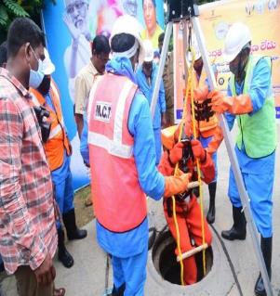
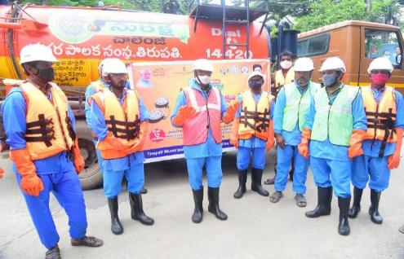

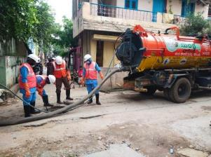
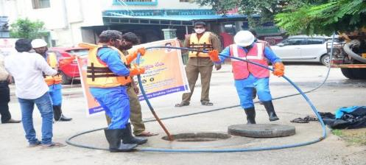


E
I
C
Training and capacity building –
Safai Karamcharis Sanitation Staff
A group of 96 members drawn from the family Members of safai karamcharis and equipped them with professional training to deal with the UGD network
Identified, trained and integrated informal workers (Safai Karamcharis) into formal UGD O&M Operation Workers UGD NetWork
Regular training and capacity building activities
2 – 5 Training Sessions conducted in a month

Slide 10
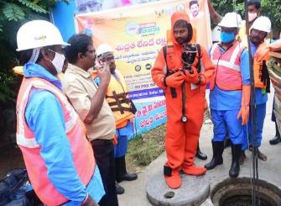
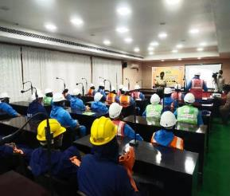
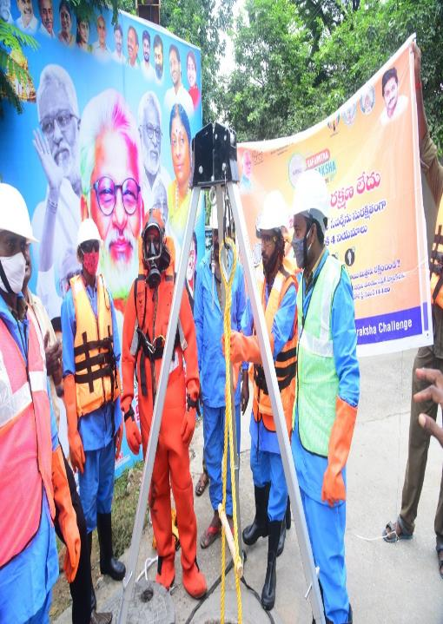
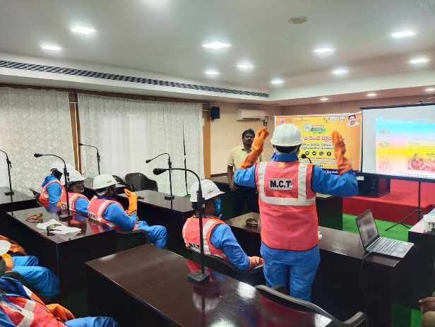
Training and capacity building
Waterborne Sanitation Staff

Slide 11
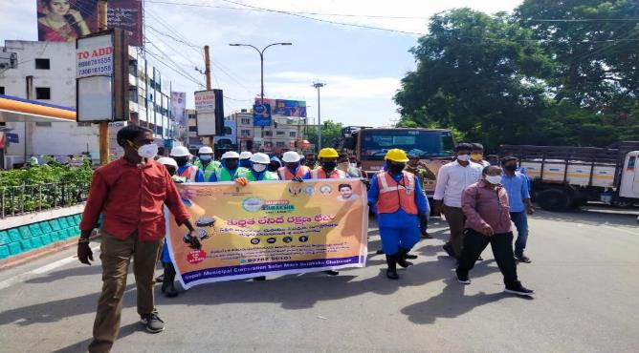
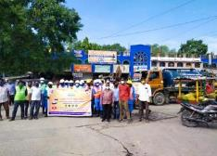
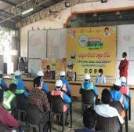
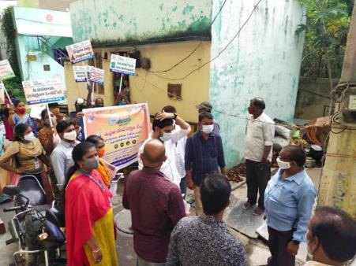
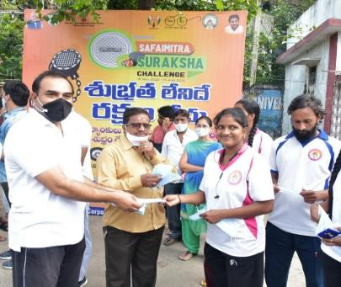

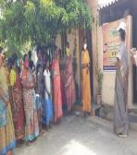
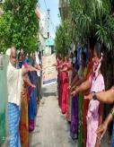
IEC ACTIVITIES CONDUCTED
14420 HELP LINE
ON CLEANING SEPTIC TANKS AND SEWERS
ON PENAL ACTIONS ON NON-COMPLIANCE
E
I
C

Slide 12
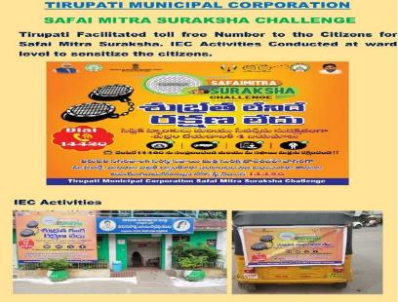
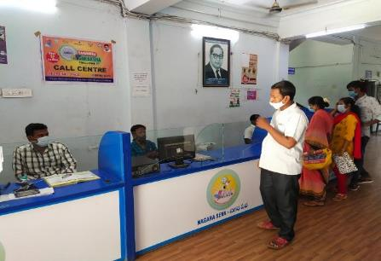
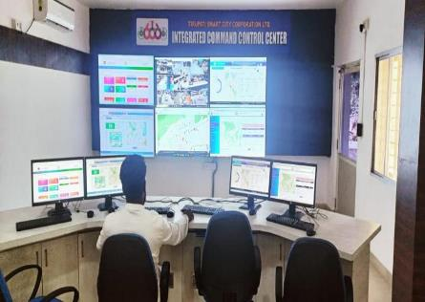
14420
Tirupati municipal corporation created awareness to citizens of Tirupati on a dedicated helpline number- 14420 that has been set up to register complaints and provide real-time solutions on desludging / sewer overflow.
COMMAND CONTROL ROOM
EFFICIENT MAINTENANCE OF SEWER LINES & SEPTIC TANKS
The calls from public is received in the office by a receptionist who sits in the main lobby of the Municipal office and the nature of the complaint and other details noted down by other assistant immediately forward the complaints related to UGD network overflow or septic tank cleaning and any other kind of grievances to the Area Supervisor, if the complaint redressal is beyond their purview the next level Assistant Engineer or Deputy Executive Engineer will clear the issues. The complaint registers and database is well managed.
TOLL FREE number for cleaning & Maintenance of septic tanks, sewers in the city.

Slide 13
TESTIMONIALS
My name is T Ekambaram and I am working as a sewer-men in Tirupati municipal corporation from last 8 years. I used to clean sewers in the city. I always faced uncertainty before entering a manhole. There might be water up to ten feet and when we inhale the poisonous gases inside the manhole, our head starts spinning. With the introduction of Safaimitra suraksha, we got well equipped with all safety measures and regular training activities. All manholes were transformed to machine-holes in the city. My job became easier with the introduction of sewer cleaning machinery. I have been paid with 12000 rupees as a monthly salary and 6000 rupees as a hazardous risk allowance every month. My family is happy because of the welfare schemes and education provided to our children in SPJNM Municipal school. The corporation also provided health insurance through NSKFDC. We have been provided with PPE and safety gear like wader suit, safety tripods, Nylon rope Ladders, Breathing apparatus, sewer inspection cameras and gas monitors for our safety. Periodical Health check-up programmes introduced by the corporation as a “e-Health” services made our lives hale and healthy. The corporation is helping us by providing groceries and other amenities to us once in every 3 months.

Slide 14
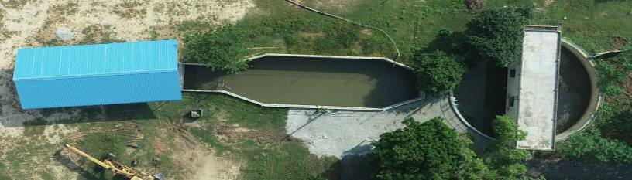
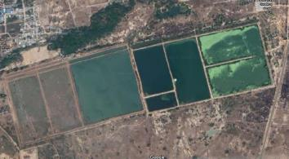
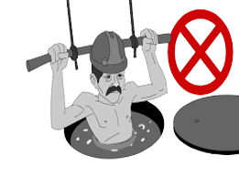
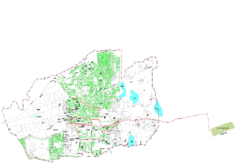
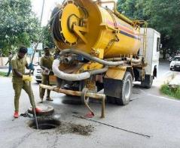

STP AT THUKIVAKAM, TIRUPATI
Tirupati has An extensive sewerage network that covers nearly 90% of the area.
About 300 acres of land has been allotted for the facility in which the actual facility spread over 130 acres.
COST OF THE PROJECT : 19 Cr
Installed Capacity: 50 MLD
Households Benefited: 104057
Area Covered : 90 %
The liquid waste (31.5 MLD sewerage) & Feacal sludge (1.5 MLD) Received via. Sewerage Conveyance system and from desludging operators is being treated at STP- FSTP Co-Treatment Facility and a volume of 24 MLD of treated STP water is reused.
Sold 5 MLD to Srikalahasthi Pipes Ltd. and generating a revenue of 6 Lakhs Rupees / Month.
18 MLD supplied to the farmers for agriculture purpose – on free of cost.
Reused by the ULB for Road/street
cleaning, for watering road
medians, parks and gardens in the
city.
EXISTING SEWERAGE NETWORK MAP

Slide 15
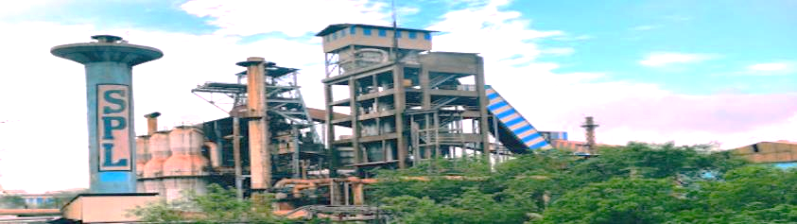
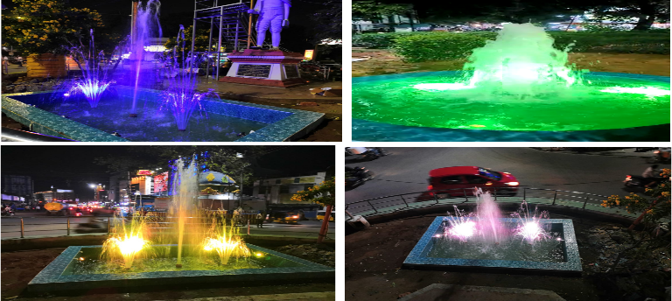
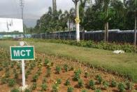
O&M COST - RECOVERY
REUSE OF TREATED WATER IN TIRUPATI
The revenue streams like
Sewerage charges
and
sale of treated STP water
covers entire O&M costs
24 MLD of treated STP water (100%) is reused
Sold 5 MLD to Srikalahasthi Pipes Ltd. and generating a revenue of 6 Lakhs Rupees/Month
Used in spraying water on roads to suspend dust particles while sweeping
TIRUPATI Introduced water fountains at traffic intersection at various places to reduce air pollution in the city utilizing treated effluent from STP
Reused for watering plants on road medians & in parks
****** Remaining water is released to farmers for Agriculture purpose on free of cost

Slide 16
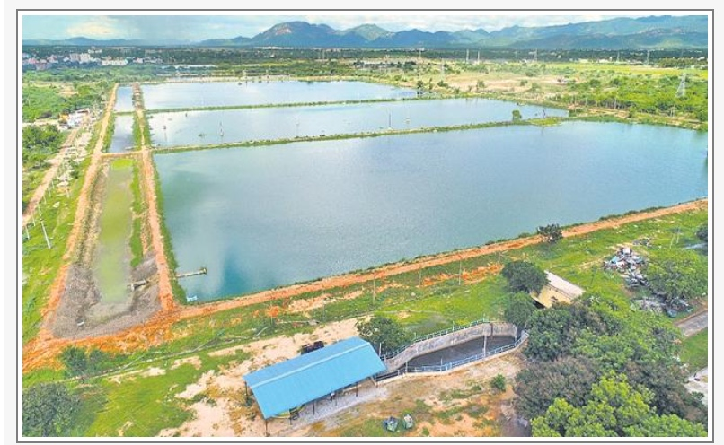
Water Plus
Declared as the South India’s 1ST- ‘Water Plus' city in Swachh Survekshan 2021

Slide 17
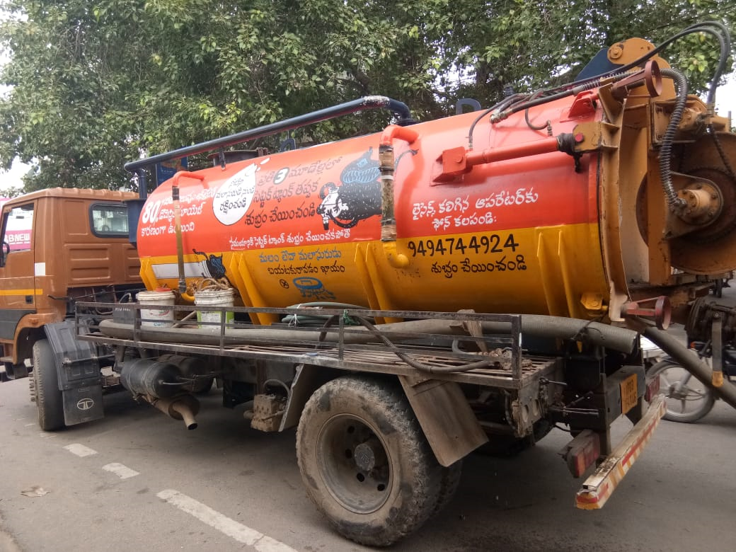
Thank You

