Slide 1


Slide 2


“National Action For Mechanized Sanitation Ecosystem” (NAMASTE)
Presentation to the AMRUT cities
17.08.2022 at 10:00 AM
Department of Social Justice and Empowerment
Ministry of Social Justice and Empowerment

Slide 3

NAMASTE
  National Action for Mechanised Sanitation Ecosystem (NAMASTE) :
  A central sector scheme of MoSJE& MOHUA :
  For identifying the people engaged in hazardous cleaning operations
  Enhancing occupational safety through capacity building
  Provide individual safety gear and machines.
  Formation into Self Help Groups
  Providing sustainable livelihoods
  Components of NAMASTE:
  Survey of Sewer/Septic Tank Workers (SSWs)
  Health Insurance coverage of SSWs under PM-JAY- Premium to be made
  Skilling and Entrepreneurship Development Programme (EDP) support for enterprise development in alternate trades to SSWs/dependants
  Capital Subsidy to SSWs/Dependants for projects in alternate trades
  Occupational safety training and skilling of SSWs (upskilling/RPL)
  Capital Subsidy for procurement of Sanitation Related Vehicles/Equipments
  IEC Campaign
3

Slide 4

Coverage: Cities
Five hundred cities (converging with AMRUT cities) will be taken up under this phase of NAMASTE. The list of cities will be notified at an appropriate time. The category of cities that will be eligible are given below:
All Cities and Towns with a population of over one lakh with notified Municipalities, including Cantonment Boards (Civilian areas),
All Capital Cities/Towns of States/ Union Territories (UTs), not covered in 3.3 (i) a
Ten Cities from hill states, islands and tourist destinations (not more than one from each State).
4

Slide 5

Strategy
Establish convergence amongst key stakeholders
City-wide approach for implementation at granular level.
Forming community-based institutions of sanitation workers and their enablement to run sanitation enterprises and ensure linkages to social and financial entitlements.
Focused program design and implementation, including institution building and capacity strengthening.
Focus on a process that will have active participation from stakeholders to generate “ownership” and “buy-in” at the State and ULB levels.
5

Slide 6
Implementation Module
Organisational Structure
National Coordination Committee headed by Secretary, MoSJE and members from concerned Ministries/Departments
NSKFDC
National NAMASTE Management Unit
Technical Support Unite
Regional /State NAMASTE Management Unit
Regional /State NAMASTE Management Unit
Regional /State NAMASTE Management Unit
Cluster (of ULBs) Namaste Management Unit
Cluster (of ULBs) Namaste Management Unit
Cluster (of ULBs) Namaste Management Unit
Cluster (of ULBs) Namaste Management Unit
Cluster (of ULBs) Namaste Management Unit
6

Slide 7

Convergence of Programmes of MoSJE & MoHUA
Role of MoSJE:
Creation of National NAMASTE Management Unit (NNMU), State NAMASTE Management Units (SNMU) and City NAMASTE Management Units (CNMU).
Putting in place the organizational setup with PMU (Project Management Unit) in a 3 tier structure.
Coordination with MoHUA, other Ministries and other implementing agencies.
Setting up of Technical Support Unit for robust IT enabled MIS including development of website and mobile apps. Health Insurance coverage of SSWs under PM-JAY- Premium to be paid Skilling and Entrepreneurship Development Programme (EDP) support for enterprise development in alternate trades to SSWs/dependants: Occupational safety training and skilling of SSWs (up-skilling/RPL) Capital Subsidy to SSWs/Dependants for projects in alternate trades Capital Subsidy for procurement of Sanitation Related Vehicles/Equipments
IEC Campaign
Monitoring of implementation.
7

Slide 8
Role of MoHUA
The financing of the Action Plan shall be leveraged under the Schemes of MoHUA (SBM and DAY-NULM) particularly for the following interventions:-
SHG formation of sewer/septic tank workers
PPE procurement
Safety devices and equipment procurement
Occupational safety training and skilling for SEPs & Duty Supervisors
Providing work assurance to sanitation workers interested in availing Sanitation Related Projects.
Sensitisation of ULBs and follow up of implementation with them.
8

Slide 9
Role of ULBs
To ensure skilling of SSWs in operation of mechanized cleaning equipments.
No manual cleaning of sewer/septic tanks without protective gears and written permission of CEO as prescribed in MS, Rules.
To provide work assurance for identified SSWs for seeking loan under SUY scheme.
Sensitisation and IEC campaign for costumer awareness and for SSWs and empanelled venders.
To ensure Health Insurance Coverage all identified SSWs under PM-JAY.
To saturate all social security scheme among identified SSWs.
To promote mechanisation of cleaning operation through Swachhata Udyami Yojana (SUY)
9

Slide 10

Intended Outcomes
Zero fatalities in sanitation work in urban India.
All sanitation work is performed by skilled workers.
No sanitation worker comes in direct contact with human faecal matter.
Sanitation workers are collectivized as SHGs and are empowered to run sanitation enterprises.
All Sewer and Septic tank sanitation workers (SSWs) have access to alternative livelihoods.
Strengthened supervisory and monitoring systems at national, state and ULB levels to ensure enforcement and monitoring of safe sanitation work.
Increased awareness amongst sanitation services seekers (individuals and institutions) to seek services from registered and skilled sanitation workers.
10

Slide 11
Support provided to the ULBs under NAMASTE

Slide 12

Functions and Compositions of Various Units
PMU
National NAMASTE Management Unit (NNMU)
NNMU would devise various reporting and monitoring formats, training modules for PMU resource. It will monitor the implementation of scheme through robust IT enabled system, support the City Namaste Management Units and provide various report to the management.
--------------------------------------
10 PMU resources
City NAMASTE Management Unit (CNMU)
It will be responsible for enumeration, SHG formation, providing benefits provisioned under NAMASTE to target group and reporting progress to State/ National Level monitoring units.
-------------------------------
263 PMU resources
State NAMASTE Management Unit (SNMU)
The Unit will provide support to the CNMU and will be responsible for monitoring of implementation of the scheme in the State.
---------------------------------
27 PMU resources
12

Slide 13
Engagement and Role of PMU
ULB level:
The Project Management Unit (PMU) @ one per a cluster of municipalities
Each PMU comprising of 2-3 professionals
Works in coordination teams of SBM/NULM
Responsible for:
  Survey/enumeration
  Formation of SHGs – collaborate with ULBs for securing work orders
  Provide protective gear (funded by ULB) and machines under SUY
  Ensure access to the social security measures
  Livelihood plans including skilling
State level:
One NAMASTE Manager for ULBs under that State
State level SBM Directors PMU resource as per need.
13

Slide 14
Physical and Financial allocations
Detail | Unit cost | Physical | Financial (in Rs Cr)
Survey of Sewer/Septic Tank Workers (SSWs) | Rs. 50 per worker | 100000 | 0.5
PMU Members Remuneration | Rs. 55,000 per RP | 654 | 38.214
Health Insurance coverage of SSWs under PM-JAY- Premium to be madeRs. | Rs. 1252 per SSWs family | 320000 | 40.064
Skilling and Entrepreneurship Development Programme (EDP) support for enterprise development in alternate trades to SSWs/dependents | Rs. 25,000 per candidate | 20000 | 50
Capital Subsidy to SSWs/Dependents for projects in alternate trades | Rs.100000/-per Project (average amt.) | 3200 | 32
Occupational safety training and skilling of SSWs (upskilling/RPL) | Rs.3000/- per candidate | 18000 | 5.4
Capital Subsidy for procurement of Sanitation Related Vehicles/Equipment | Rs. 3,75,000/-per beneficiary (av) | 2850 | 106.88
IEC Campaign (3%) |  |  | 8.44
A&OE (2%) |  |  | 5.74
Total |  |  | 287.24

Slide 15

Total Financial Outlay
Year | Outlay (Rs Cr)
2022-23 | 58.14
2023-24 | 80.15
2024-25 | 71.85
2025-26 | 77.11
Total | 287.24
15

Slide 16


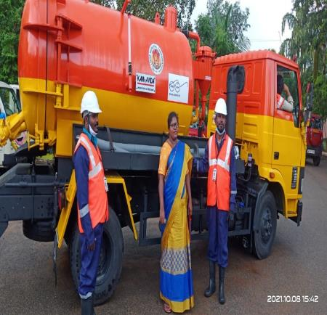
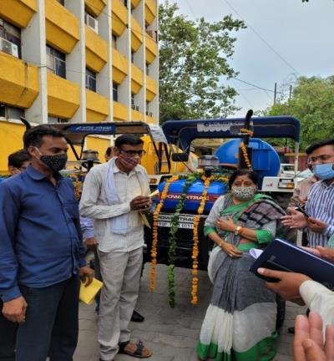
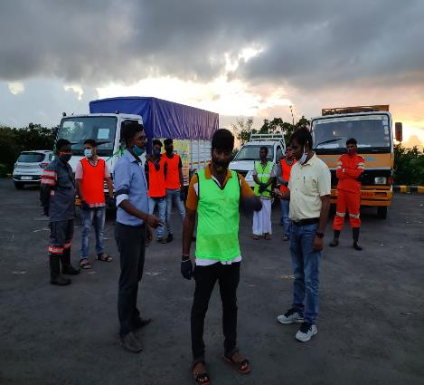
Swachhta Udyami Yojana (SUY)
Provision of financial assistance for procurement and operation of various sanitation related equipments/vehicles like De-sludging Vehicles/Cesspool Emptier, Rodding & Jetting Machines, Suction Machines, Grabbers, De-silting machines, Garbage Tippers and other sanitation related equipments etc.
Twin objectives :
elimination of manual hazardous cleaning, promoting mechanised cleaning
Provision of sustainable livelihood opportunities.
Financial assistance provided to individual as well as Group/SHGs/Cooperatives.
Nellore
Ghaziabad
Port Blair
16

Slide 17



Swachhta Udyami Yojana (SUY)
KEY FEATURES:
The scheme is being implemented since FY 2020-21.
Loans through Channelizing Agencies of NSKFDC/Financial Corporation/ Banks
Projects upto Rs.15.00 Lakhs for Individuals and upto Rs.50.00 Lakhs for Group Projects
Rate of interest 4%
Interest rebate for Women/ timely repayment
Repayment period upto 7 years
Subsidy under SRMS
Type of Project | Range of Project Cost (Rs.) | Capital Subsidy
Individual | Upto Rs. 5,00,000 | 50% of project cost
 | 5,00,000 to 15,00,000 | Rs. 2.5 lakh + 25% of remaining project cost. Maximum subsidy Rs. 5.00 lakh.
Group (maximum 5 members) | Upto Rs. 10,00,000 lakh per beneficiary and project cost upto Rs. 50,00,000 | Same as admissible to individuals subject to maximum Rs. 3.75 lakh per beneficiary
Interest Subsidy : For the interest rate over and above 6% per annum charge by Bank.
17

Slide 18
Thank you

