Slide 1


Slide 2



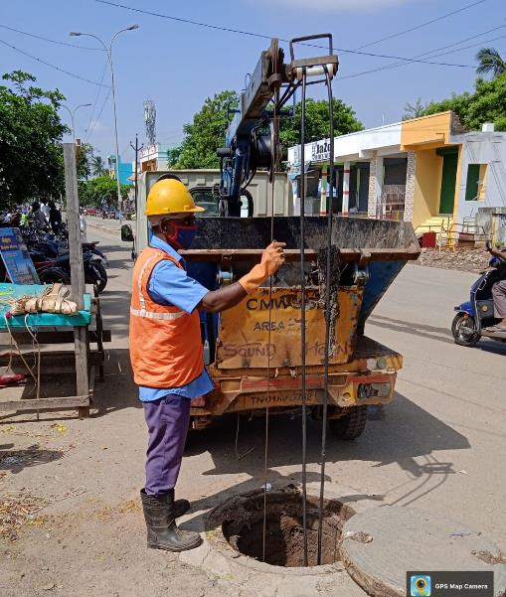

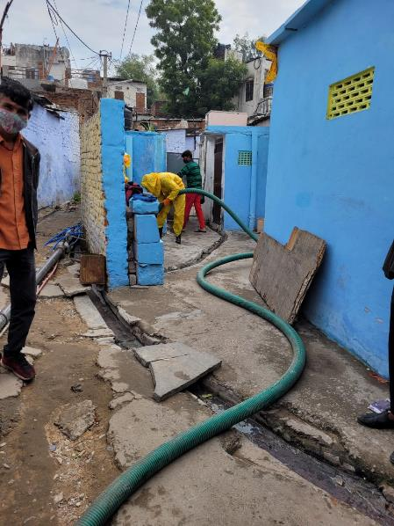
SafaiMitra Surakshit Shehar

Slide 3
Challenges in the sector
Ad-hoc nature of operations in the sector
1
Infrastructural challenges – e.g. deep septic tanks, no vents
2
3
Inadequate prevention maintenance regime at household and city level
4
Inadequate mechanization and modernization of sanitation infrastructure
Vulnerable workers with no bargaining power engaged
5
Poorly trained and improperly equipped workers
6
Entry into sewers and septic tanks without safety infrastructure
7

Slide 4
Approach for SafaiMitra Suraksha
Zero fatality in sanitation work
Strategy
Key Initiatives
Responsible Sanitation Authority at the District Level
Emergency Response Sanitation Unit at each district HQ
Emergency Helpline 14420
Adequate availability of equipment
Enumeration and training of core sanitation workers
SOP for cleaning septic tanks and sewers
Technology challenge
Institutional framework
Norms and protocols for equipment and workforce
SafaiMitra Suraksha Challenge – 246 MCs
100 Lighthouse cities identified
SafaiMitra Surakshit Shehar

Slide 5
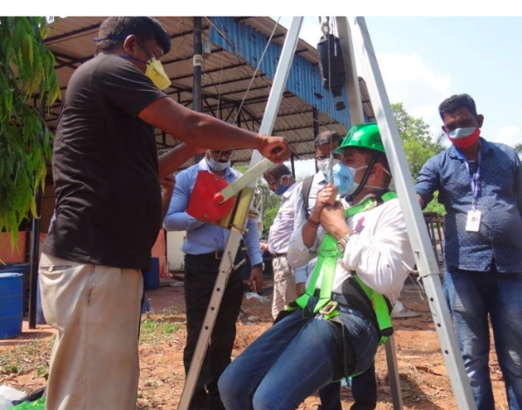
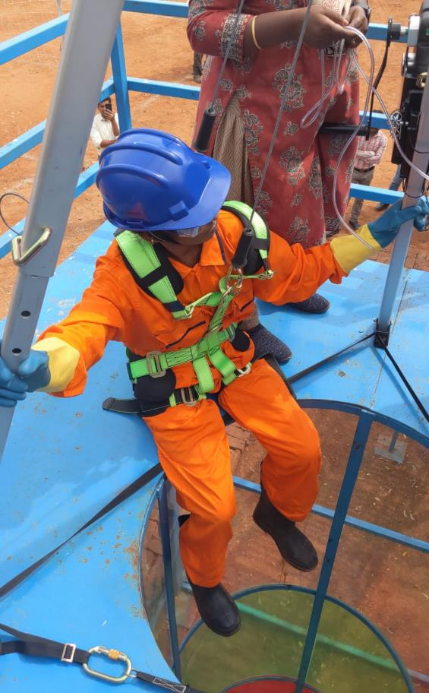
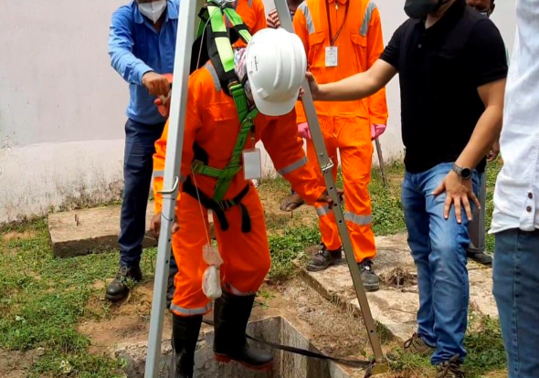
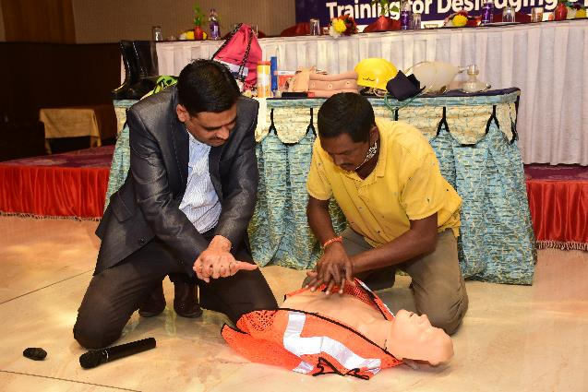
Training of SafaiMitras

Slide 6
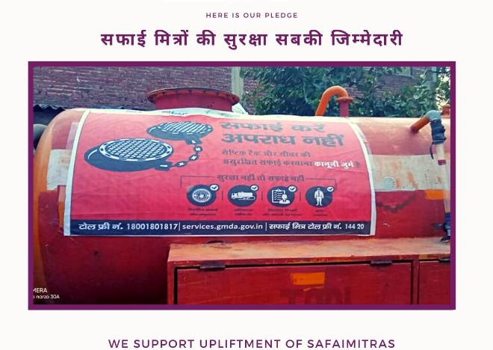
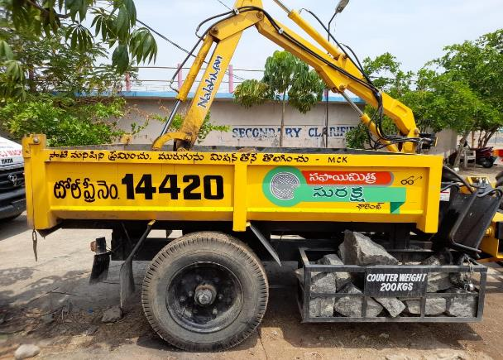
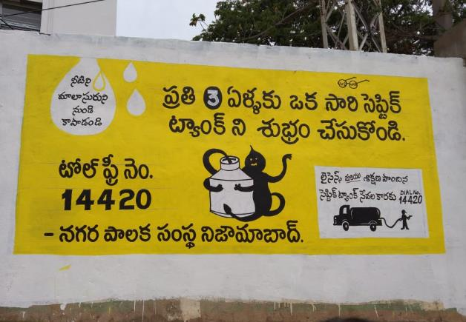
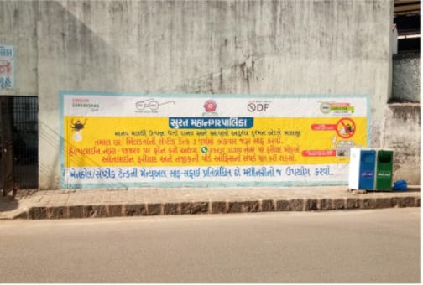
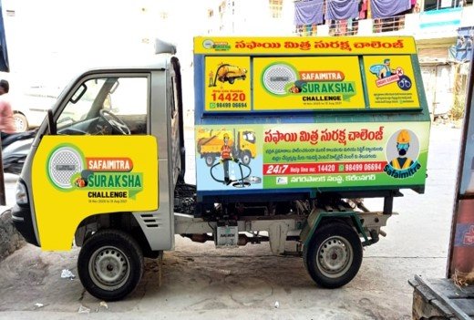
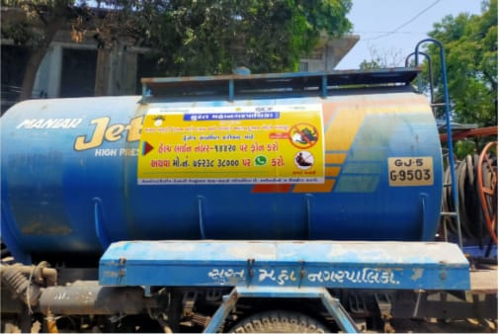
Awareness Generation

Slide 7
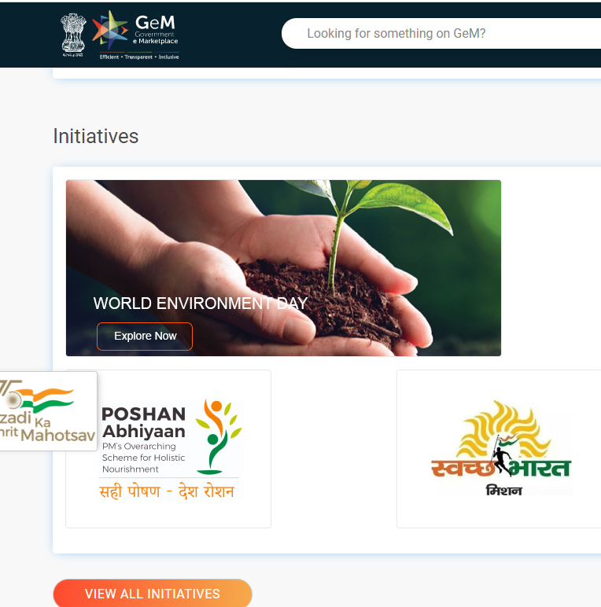
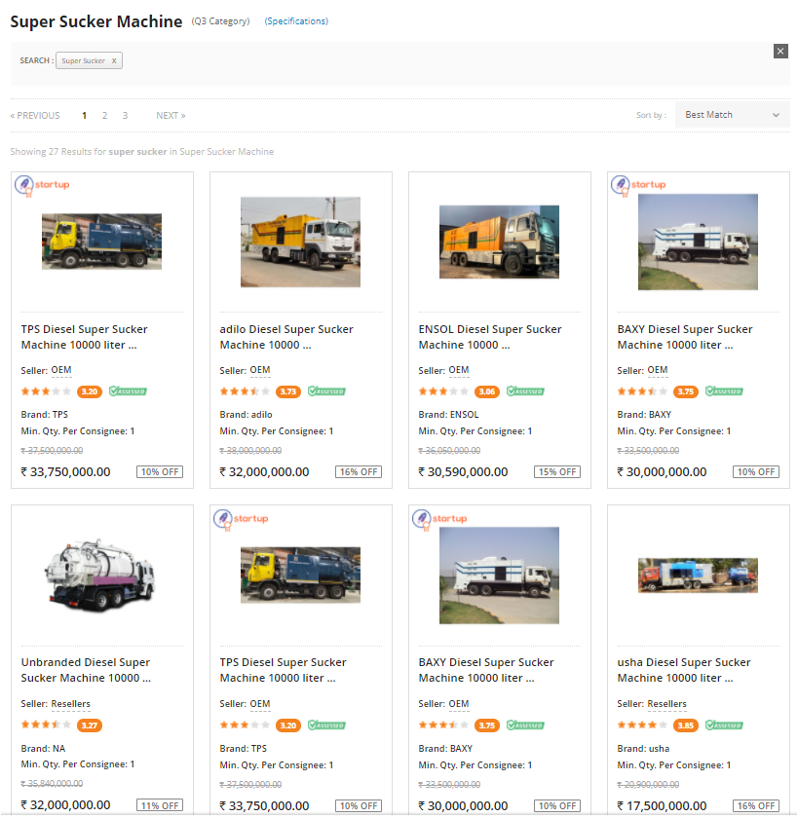
Adequate availability of Equipment
Transactions of sewer maintenance equipment on GeM of order value ~ INR 300 Cr during 2021-22
Drain cleaning machine developed by CISR-CMERI listed on GeM
7

Slide 8
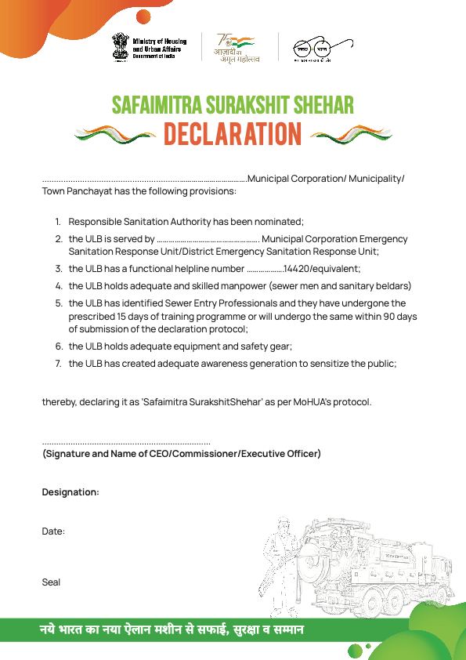
SafaiMitra Surakshit Shehar protocol
Declaration by ULBs
Declaration from Ward Councillors/Mayor
(within 4 weeks from the date of declaration)
Third party validation
(within 12 weeks from the date of declaration)

Slide 9
Declaration of SafaiMitra Surakshit Shehar

Slide 10
94 Lighthouse Cities have declared themselves SafaiMitra
Surakshit Shehar
500 Cities
406 Non-Lighthouse Cities have also declared themselves SafaiMitra
Surakshit Shehar
Notes:
© Copyright PresentationGO.com – The free PowerPoint and Google Slides template library

Slide 11
State | Lighthouse Cities | ULB Name
MAHARASHTRA | 18 | Ahmedanagar, Amravati, Aurangabad, Chandrapur_M, Dhule, Kolhapur, Greater Mumbai, Nagpur, Malegaon, Vasai Virar, Parbhani, Pimpri Chinchwad, Pune, Bhiwandi Nizampur, Kalyan Dombivali, Mira-Bhayandar, Navi Mumbai, Thane
MADHYA PRADESH | 17 | Bhopal, Chhindwara, Dewas, Gwalior, Indore, Jabalpur, Khandwa, Khargone, Morena, Katni, Ratlam, Rewa, Sagar, Satna, Sehore, Singrauli, Ujjain
CHHATTISGARH | 13 | Jagdalpur, Bilaspur, Dhamtari (M), Bhilai Charoda (M), Bhilai Nagar, Durg, Risali (Nn), Korba, Chirmiri, Raigarh, Birgaon (M), Raipur, Ambikapur
UTTAR PRADESH | 10 | Aligarh (M. Corp), Noida, Ghaziabad (M. Corp), Gorakhpur (M. Corp), Meerut (M. Corp), Prayagraj (M. Corp), Saharanpur (M. Corp), Shahjahanpur (M. Corp), Lucknow (M. Corp), Varanasi (M. Corp)
TELANGANA | 7 | Greater Hyderabad, Karimnagar, Khammam, Nizampet, Nizamabad, Ramagundam, Warangal
GUJARAT | 6 | Ahmedabad, Bhavnagar, Jamnagar, Rajkot, Surat, Vadodara
ANDHRA PRADESH | 5 | Tirupati, Kakinada, Rajahmundry, Nellore, Gvmc Visakhapatnam
PUNJAB | 5 | Bathinda, Abohar (M Cl), Ludhiana, Patiala, S.A.S. Nagar (Mohali)
ODISHA | 3 | Baleshwar Town (M), Brahmapur (M Corp), Bhubaneswar
KARNATAKA | 2 | Hubli-Dharwad, Mysore
RAJASTHAN | 2 | Ajmer, Bikaner
BIHAR | 1 | Gaya
CHANDIGARH | 1 | Chandigarh
HARYANA | 1 | Gurgaon
JAMMU AND KASHMIR | 1 | Srinagar
JHARKHAND | 1 | Jamshedpur
UTTARAKHAND | 1 | Roorkee (Nn)
Total | 94
Notes:
© Copyright PresentationGO.com – The free PowerPoint and Google Slides template library

Slide 12
State | Non-Lighthouse Cities
CHHATTISGARH | 156
MADHYA PRADESH | 152
GUJARAT | 16
TELANGANA | 16
KARNATAKA | 13
UTTAR PRADESH | 13
MAHARASHTRA | 12
TAMILNADU | 9
ODISHA | 4
DELHI | 3
HIMACHAL PRADESH | 3
JHARKHAND | 2
ANDAMAN AND NICOBAR ISLANDS | 1
ANDHRA PRADESH | 1
BIHAR | 1
JAMMU AND KASHMIR | 1
LADAKH | 1
MIZORAM | 1
UTTARAKHAND | 1
Total | 406
Notes:
© Copyright PresentationGO.com – The free PowerPoint and Google Slides template library

Slide 13
Regional Analysis
Region | Lighthouse Cities | Non-Lighthouse Cities
Union Territories | 2 | 6
North | 17 | 17
South | 14 | 39
Central (MP) | 17 | 152
West | 26 | 28
East | 18 | 164
Total | 94 | 406
City Class Analysis
Region | Lighthouse Cities | Non-Lighthouse Cities
Mega Cities | 5 | 2
Million Plus Cities | 22 | 6
Other Amrut Cities | 57 | 36
Non-Amrut Cities | 10 | 362
Total | 94 | 406
Notes:
© Copyright PresentationGO.com – The free PowerPoint and Google Slides template library

Slide 14
States/UTs with Nil Declaration (12)
West Bengal
Kerala
Assam
Goa
Manipur
Tripura
Nagaland
Meghalaya
Arunachal Pradesh
Sikkim
Puducherry (UT)
Dadra and Nagar Haveli (UT)
Notes:
© Copyright PresentationGO.com – The free PowerPoint and Google Slides template library

Slide 15
Way Forward
2022
2023
2024
Plan
Aug
Mar
Aug
Mar
Mar
15th Aug
Saturation of at least
75 lighthouse ULBs
31st Mar Saturation of 25% ULBs in each State
31st Aug Saturation of 50% ULBs in each State
31st Mar
Saturation of 100% ULBs
2022
Actual
Aug
Mar
15th Aug
487 ULBs declared as adequate

