Slide 1

DICCI (Yet to recieve)

Slide 2

Socio-Economic Empowerment of
Manual Scavengers, Safai Karamcharis, Scheduled Castes & Scheduled Tribes through
Entrepreneurship

Slide 3
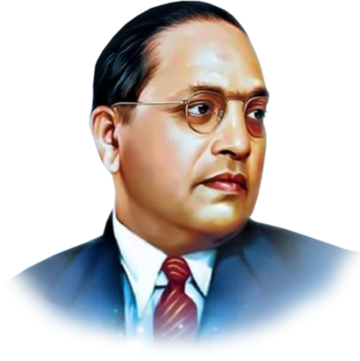

Dr. Ambedkar’s vision of economic empowerment through Self-help and Entrepreneurship.
DALIT INDIAN CHAMBER OF COMMERCE AND INDUSTRY
Established in 2005 in Pune, by Dr. Milind Kamble
VISION
Developing SC-ST Business Leadership
Inculcating the spirit of entrepreneurship among the SC-ST communities for developing business leaders.
MISSION
Be Job Givers
Encouraging SC-ST youth to become entrepreneurs in business & industry sectors by supporting them in their ventures to become job givers, taxpayers, wealth creators and contributors to the national economy.
AIM
Challenging Caste with Capital

Slide 4


‘Sani-Preneur’ (Sanitation Entrepreneur) Development Ecosystem
for
Comprehensive Waste Management Solutions

Slide 5
Manual Scavenger/ Safai Karamchari/ SC-ST
Municipal Corporation/ ULBs/ Cantonment Boards
Financial Institutions /Banks
NSKFDC/NSFDC
OEMs / Vehicle Manufacturer
NSDC/Skill Development Org.
MoSJE / MoHUA
DICCI Sani-Preneur Development Ecosystem
Stakeholders
DICCI

Slide 6
Stakeholder engagement
Local Civic Body
DICCI
Sewerage & Septage Contractual Framework
Local Civic Bodies to engage with DICCI to understand the local sewerage & septage (sanitation) maintenance needs and formulate a joint framework for tailor made solutions through contractual tenders,
Preferential order in tender conditions for Family member of Deceased labour/ Manual Scavenger/ Safai Karamchari/SC/ ST
Linkage of In-principle sanction of loan under GOI’s flagship Stand Up India (SUI) scheme for machine procurement
Provision of Group Management Agency for hand holding O & M.

Slide 7
Sani-Preneur Development Process
Mobilisation
Identification
Entrepreneur Support Ecosystem
Documentation
Bank/OEM/ Vehicle manufacturer/ Fabricator Linkage
Bidding Support
DICCI shall engage in Mobilisation, Mentoring & Hand Holding of Family member of Deceased Labour/ Manual Scavenger/ Safai Karamchari/ SC/ ST contractor aspirants,
Documentation
Tender process assistance
Bank linkage for In-principle sanction letter under SUI scheme
Equipment/Vehicle manufacturer, Machine fabricator linkage
Tender bidding support

Slide 8

Financial Assistance Linkage
SUI Loan Application
SUI Loan Sanction
Disbursal –Chassis Mfg.
Chassis Delivery to Fabricator
Disbursal - Fabricator
Machine Delivery to Contractor
For the successful bidders, as a hand holding agency in SUI ecosystem DICCI shall assist in the bank’s loan sanctioning process for the timely procurement of the machines,
Loan application assistance – documentation & submission
Agreement for ESCROW payment mechanism by Civic body to the bank
Step 1 disbursal – Vehicle/Chassis manufacturer
The Vehicle/Chassis manufacturer makes the delivery to the machine fabricator’s factory
Step 2 disbursal – Machine Fabricator
Subsequent to fabrication of the machine it is delivered to the contractor for deployment at respective civic body.

Slide 9
Sani-Preneur Hand Holding
Group Management Agency
Single Window Project Operations & Maintenance
Banking Operations/ ESCROW mechanism
Assistance for Other Operational Compliance
Assistance for Central/State Govt(s) Subsidy schemes
DICCI shall mentor the formation of Group Management Agency enabling Single Window Contact between the Civic Body and Contractors for,
Operations and maintenance of the machines
Financial management assistance to contractors
EMI repayment of loans through ESCROW account
Enabling compliance subject to operations as applicable by the State/Central Govts
Assistance to contractors for any Central/State Subsidy schemes

Slide 10
Impact of Sani-Preneur Development Ecosystem
Successful linkage of Stand Up India Scheme for creating 350 sani-preneurs
Transformation of sanitation workers into first generation SC-ST entrepreneur
Daily wage earners become Tax Payers
1,400+ direct and indirent employment opportunities created
Zero deaths in sewer cleaning activities since project inception in both cities
Zero manual intervention in sewer cleaning
Citizens & Local Bodies of Hyderabad and Delhi are happy with sanitation services

Slide 11
2017
2018
DICCI engaged with Hyderabad Metropolitan Water Supply & Sewerage Board (HMWSSB)
68 SC-ST Entrepreneurs created commissioning Mini Air Tech Machines.
DICCI engaged with Greater Hyderabad Municipal Corporation (GHMC)
66 SC-ST Entrepreneurs created commissioning Jetting-cum-Suction Machines.
Sani-Preneur Projects
2019
2021
2022
DICCI engaged with Delhi Jal Board (DJB)
200 SC-ST Entrepreneurs created commissioning Sewer Cleaning Machines.
DICCI mentored Swara Sanitech, a start up for creating Toilet Integration (TI) Bus for sanitation & Hygiene services for women, for creating 1,000 Women Entrepreneurs.
DICCI mentored Honey Sucker, a technology based aggregation platform for Faecal Sludge Management (FSM), pilot being rolled out at Pune and Panajim.

Slide 12
Thank you

