Slide 1
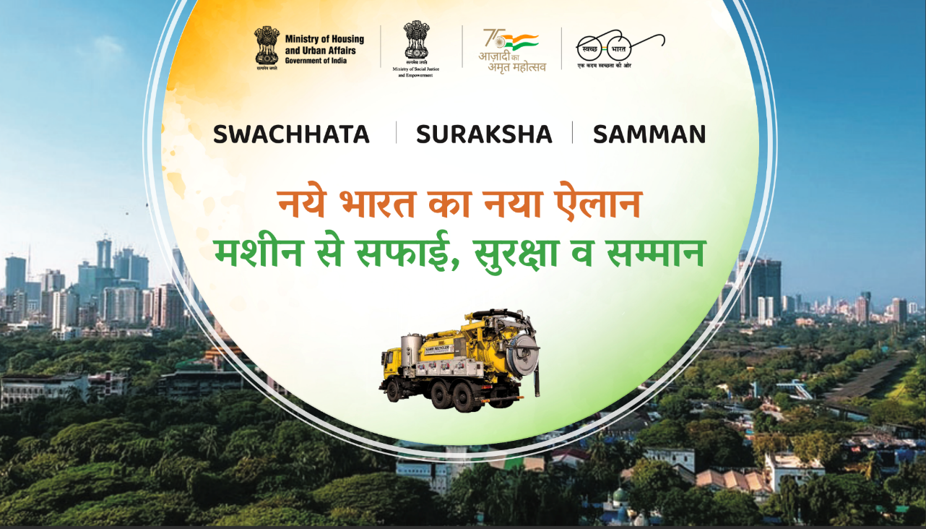
Hoarding

Slide 2




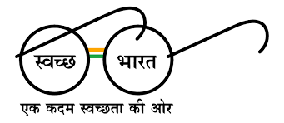
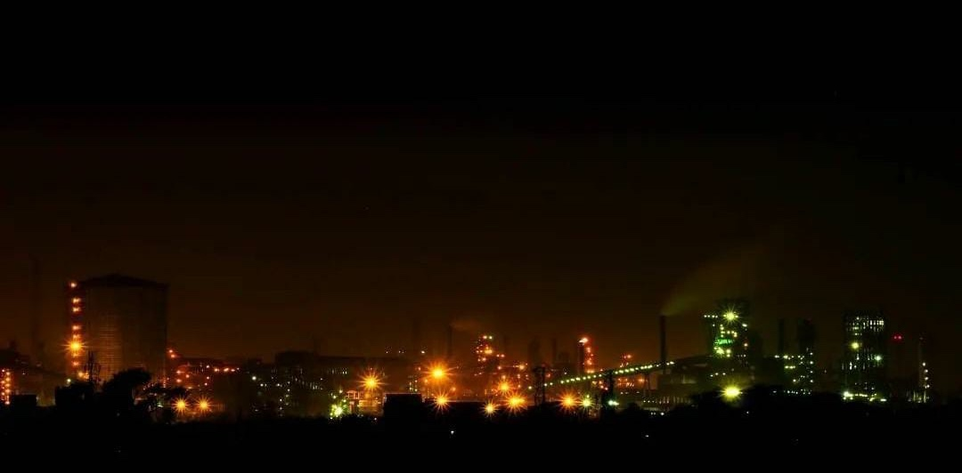
Jamshedpur
Steel City: a City of Tomorrow
Manhole turned into Machine Hole
(Elimination of Manual Scavenging in Sewer Cleaning)
Since 1st Jan 2021
Presentation by:
Sanjay Kumar (Special Officer )
Jamshedpur Notified Area Committee, Jamshedpur, Jharkhand

Slide 3






CITY BACKGROUND
Area- 64 Sq Km
No of wards -10
Population (2011)- 6.3 lakhs
Green Cover-37% (Approx)
Road Length:- 713 Km
Population covered- 7.7lakhs (Estimated)
Avg. daily water supply - 80 MLD
Length of Water Mains: - 640 Km
Length of Sewer Lines- 579 Km
4 Sewage Treatment Plant : 64 MLD
10 sewage pumping stations: Automated Operation
20000 Manhole
Total number of SafaiMitras Engaged : 133
Challenges: The conventional method of sewer cleaning requires manual entry.

Slide 4
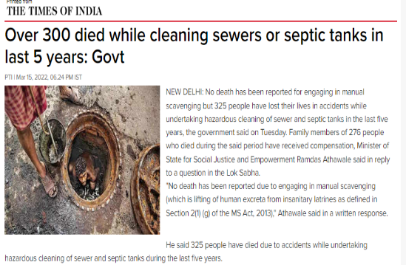
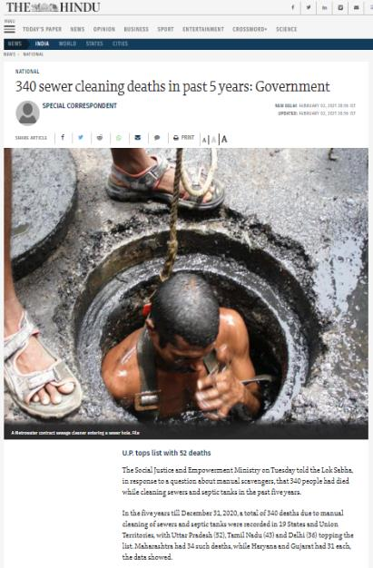
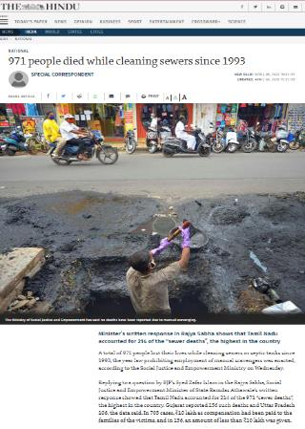
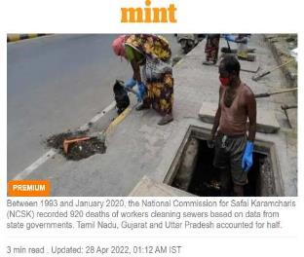
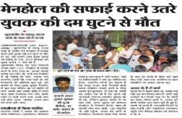
THE GREATER SOCIETAL PROBLEM

Slide 5

CHALLENGES:
Technical
Safety
Social
THOUGHT:
Design
Mechanization
Social Stigma
IDEAS:
Design Change
Study the application of various cleaning equipment
Create a healthy and safe work environment for all and create a “sense of pride” amongst the workmen involved in cleaning
ZERO MANUAL ENTRY

Slide 6
Before SafaiMitra Suraksha Challenge
ISSUES /CHALLENGES FACED DURING SEWER LINE DESILTING
Technical problem :
Non-Uniform manhole designs
Unavailability of Approach for cleaning of manholes
Unplanned construction of manholes
One solution(machine) does not address all maintenance requirements
Safety problem:
Sewer line desilting required manual entry
Exposure to poisonous gases inside manholes
Exposure to unhygienic condition leading to health hazard
Depth of manholes were different
Social Problems:
Work Dignity and Self Respect
Item | Depth in Mtr. | Quantity | Cleaning Frequency
Removing Sewer Obstruction |  | 6000 Nos. | Compt. Based
Desilting of Branch Sewer | Up to 2.0 | 213 KM. | Compt. / Requirement Based
Desilting of Main Sewer | >1.5 to 3 | 235 KM. | 2-3 Times/Year
Desilting of Trunk Sewer | >1.5 to 8 | 102 KM.
Desilting of Manhole | Up to 1.5 | 12194 Nos. | Compt. / Requirement Based
 | >1.5 to 2.5 | 6779 Nos. | 2-3 Times/Year
 | >2.5 to 8 | 1030 Nos

Slide 7
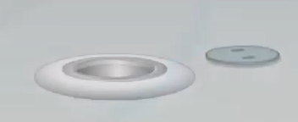
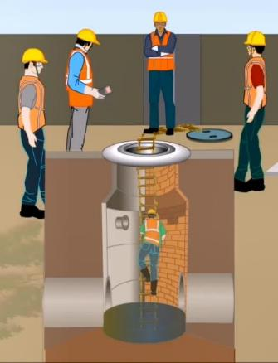
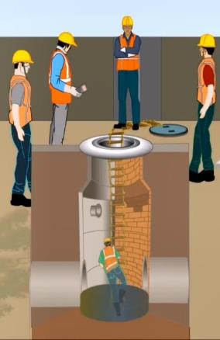
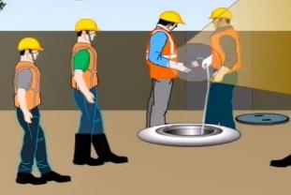
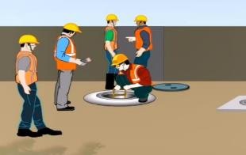
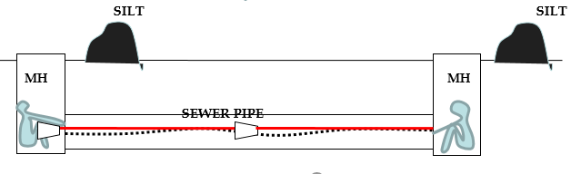
Process Followed Before SmSC
1. Opening cover
4.Workmen Entry
5.Workmen Entry
2. Checking Gases
3. Placing Rope Ladder
6. Desilting work

Slide 8
Average Activity Time & Associated Risk
MH
SILT
MH
SILT
SEWER PIPE
Approx Time line activity for Manhole Cleaning/ Each Manhole
Sr. No. | Activity | Approx. Time in Min | Risk
1 | Opening of Manhole | 1 | Low
2 | Visual Inspection of Man Hole from outside | 1 | Low
3 | Checking of Gas | 1 | Low
4 | Fixing of Entry Ladder | 1 | Low
5 | Entry of Work Men | 1 | Low
6 | Desilting of Manhole (Worker Inside manhole) | 60 | High
7 | Exit of Work Men from Manhole | 1 | Low
8 | Removal of Entry Ladder | 1 | Low
9 | Closing of Manhole | 1 | Low
 | Average Cleaning time/ Each Manhole | 68
Worker has to work in side the Manhole = 60 Min

Slide 9
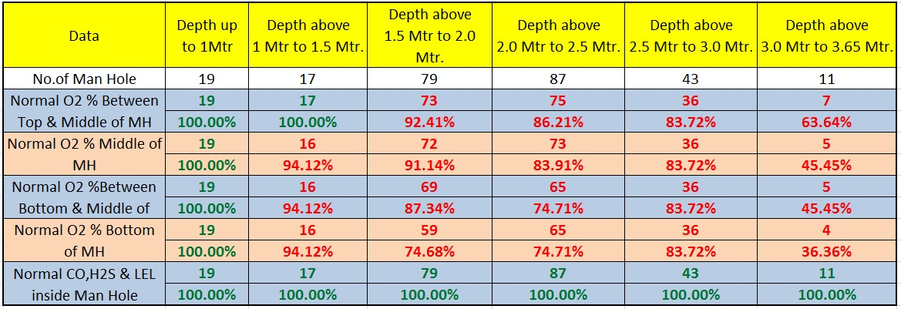
Oxygen availability inside Manhole (Depth Wise)
The availability of oxygen inside manhole decreases with increase in depth

Slide 10
Sanitation Infrastructure “Pre-SmSC”
S.No | Name of Maintenance Machine | Number of Vehicles (Nov 2020) | Requirement as per CPHEEO Manual | Number of Vehicles (July 2022)
1. | Combination Hydrovac Equipment | 2 | 3 | 3
2. | Number of Grabbers/Desilting Machines | 2 | 4 | 4
3. | Number of standard de-sludging vehicles | 2 | 2 | 8
4. | Sewer Inspection Camera Apparatus | 6 | 6 | 6
5. | Hydro Jetting Machines | 3 | 5 | 5
6. | Power Bucket machine | 1 | 2 | 2
7. | Power Rodding Apparatus | 16 | 16 | 16
8. | Hydraulic Sewer Root cutters | 1 | 3 | 3

Slide 11
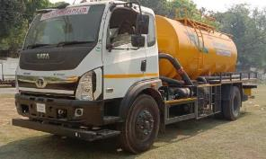
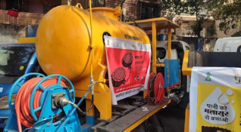
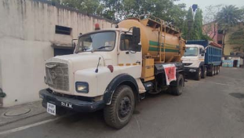
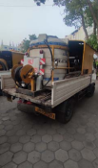
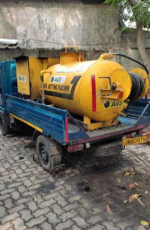
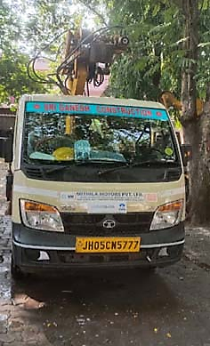
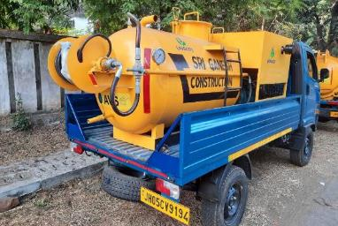
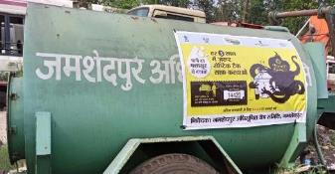
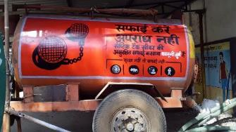
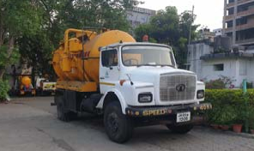
Sanitation Infrastructure “Present Day”
Super Sucker
Jetting Machine
Jetting Machine
Jetting Machine
Desludging Machine
Suction cum Jetting Machine
Grabber
Jetting Machine
Desludging Machine
Suction cum Jetting Machine

Slide 12
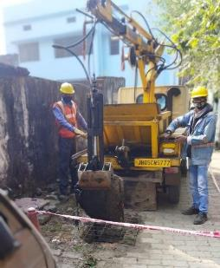
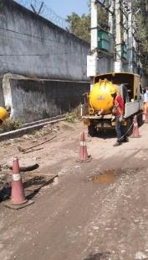
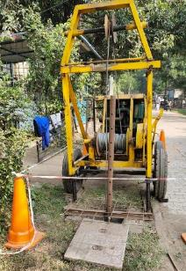
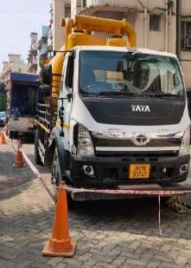
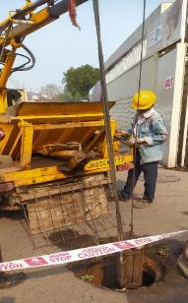
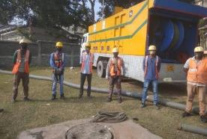
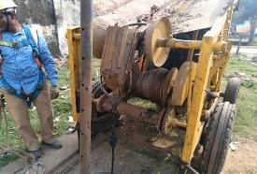
Manhole to Machine-hole since Jan 2021
Grab Machine
Suction cum Jetting Machine
Power Bucket Machine
Super Sucker Machine
Power Bucket Machine
Super Sucker Machine
Power Bucket Machine

Slide 13
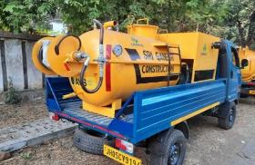
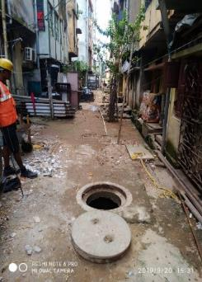
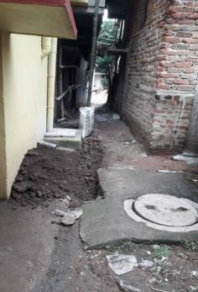
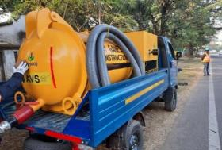
Deployment of Small Suction and Jetting Machine
Small Jetting Machine (New)
Small Suction Machine (New)
Challenges:
Benefits :-
After deployment of small suction and small jetting machine developed on TATA Intra it is easily reached up to narrow alley / non road area and not required to enter workmen inside manhole for cleaning.
Maximum Manhole up to 2 Mtr Situated at back alley or non road area
No approach for big vehicle due to encroachment.
Unsafe condition at non road area for movement of big vehicle.
Demand of customer for mechanized cleaning.

Slide 14
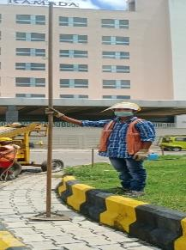
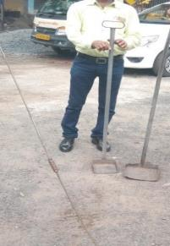
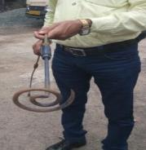
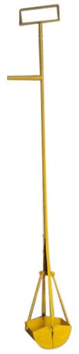
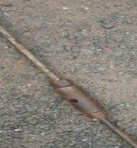
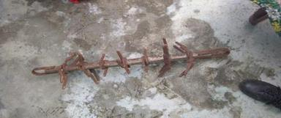
HAND MADE EQUIPMENT TO STOP HUMAN ENTRY
Hand Tools for removing Silt/Material from deep Manhole
Hand Tools for removing
Plastics, Thermos coal
Hand Grab for removing Silt/Material
Hand Tools for removing
Plastics, Thermos coal from Sewer

Slide 15
Activity time after final Implementation
Approx Time line activity for Manhole Cleaning/ Each Manhole`
Sr. No. | Activity | Earlier Activity Time in Min (R0) | Final Activity Time in Min (R2)
1 | Opening of Manhole | 1 | 1*
2 | Visual Inspection of Manhole | 1 | 1*
3 | Checking of Gas | 1 | Not Required
4 | Fixing of Entry Ladder | 1 | Not Required
5 | Entry of Work Men | 1.00 | Not Required
6 | Desilting of Manhole (Worker Inside manhole) | 60 | 0
7 | Exit of Work Men from Manhole | 1 | Not Required
8 | Removal of Entry Ladder | 1 | Not Required
9 | Closing of Manhole | 1 | 1*
 | Average Cleaning time/ Each Manhole | 68 | 3
No Worker required to work inside the Manhole
* Risk of fall of person mitigated by immediate placing of M S Grill on opening.

Slide 16
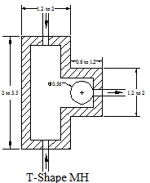
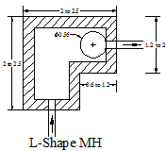
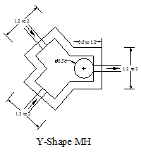
ISSUES WITH DIFFERENT TYPES OF MANHOLES
Point of manual entry
Point of manual entry
The chockage of Sewer lines are cleared through downstream manhole. Cleaning can only be ensured from the areas marked with This requires manual entry for access
Point of manual entry

Slide 17
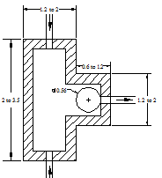
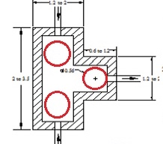
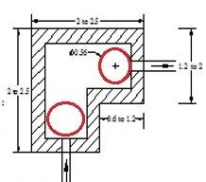
CHANGE IN DESIGN OF EXISTING MANHOLES
To further aid the cleaning mechanism 3 Nos opening were provided in T shape & 2 Nos in L Shape, after dismantling and recasting of manhole top slab
BEFORE
AFTER
Point of manual entry
Point of manual entry
point of machine pipe entry

Slide 18
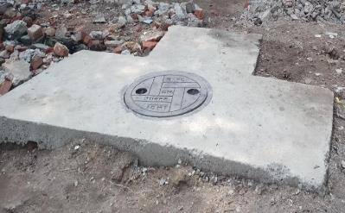
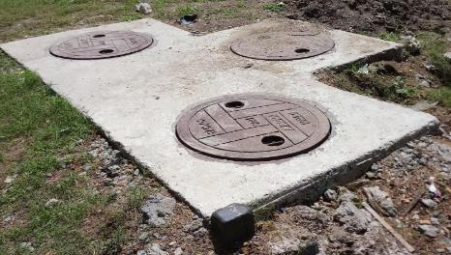


Conversion of L & T Type Manhole
AFTER
BEFORE
AFTER

Slide 19

MANUAL METHOD OF SEWER PIPE CLEANING
THEN
MH
SILT
MH
SILT
SEWER PIPE
MECHANIZED CLEANING OF SEWER PIPE USING POWER BUCKET
NOW

Slide 20


Mechanization Journey under SmSC
Formation of Responsible Sanitation Authority (RSA), Sanitation Response Unit (SRU)
Establishment of Call Centre
Establishment of Safety Training Centre
For handling of mechanized equipment special training to SafaiMitras
Public sensitization on safety measures
Purchase of Mechanized Equipment
Ban on Manual Scavenging

Slide 21




promoting Safety, Dignity and Social Security
Daily Tool Box Talk
Mandatory PPE uses
Mandatory Safety Training
Converting Manhole to Machine Hole
Geo-Tagging of all the septic tanks
Mandatory Safety Training
Daily Tool Box Talk
Converting Manhole to Machine Hole

Slide 22





promoting Safety, Dignity and Social Security
Feast for SafaiMitras
Recognition of Best Workers on monthly basis
Regular Health Checkup Camps for SafaiMitras

Slide 23




Capacity Building and Welfare Measures for SafaiMitras
Linkage to Social Welfare Schemes
Regular Mass Meeting
Linkage with PM Jivan Jyoti Bima
Regular Health Check-up Camp

Slide 24






Practices : Connecting with the Family Members

Slide 25



“Citizen Connects” to Spread Awareness for Safety of SafaiMitras
More safety to SafaiMitras
Strategic IEC outreach
Customer contact program in every 2 months in each locality
Two app's of TSUISL are used i.e Zimmedaar Nagrik and JUSCO Sahyog as customer support

Slide 26
Monitoring of workmen entry
Phase 1
Phase 2
We achieved “ZERO” workmen entry for manhole cleaning
From 1st January 2021
OTHER BENEFITS
Customer KPI | FY-19 | FY-20 | FY-21 | FY-22
Compliance within SLG | 94% | 95% | 95% | 98%
Customer Satisfaction performance score for Waste water services | 89% | 90% | 94% | 95%

Slide 27

TESTIMONIAL
For SafaiMitras
Man hole worker to a mechanized sewer worker
No Life at Risk
Better working condition
Social Security- Linked with schemes
Recognition- Working with Dignity
Uplifted SafaiMitras for a better and healthy life
Name: Mr. Baset Hasda
Occupation: Sewer Worker Working Zone: West
City: Jamshedpur State: Jharkhand
Safety
Dignity
Social Security

Slide 28




SAFAIMITRAS are the backbone of the
City, they are our Responsibility:
Some Sewer Operators & Sewer Men feeling dignified…
Vinod Jha Atisher Bhumiz Aazadi Bagti Kuna Hembrom
Thank You

