Slide 1

Hoarding

Slide 2
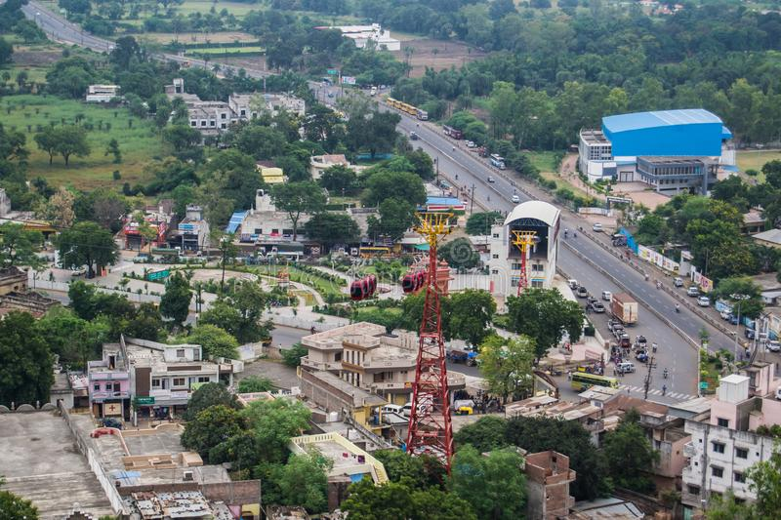


Dewas Municipal Corporation
Madhya Pradesh

Slide 3
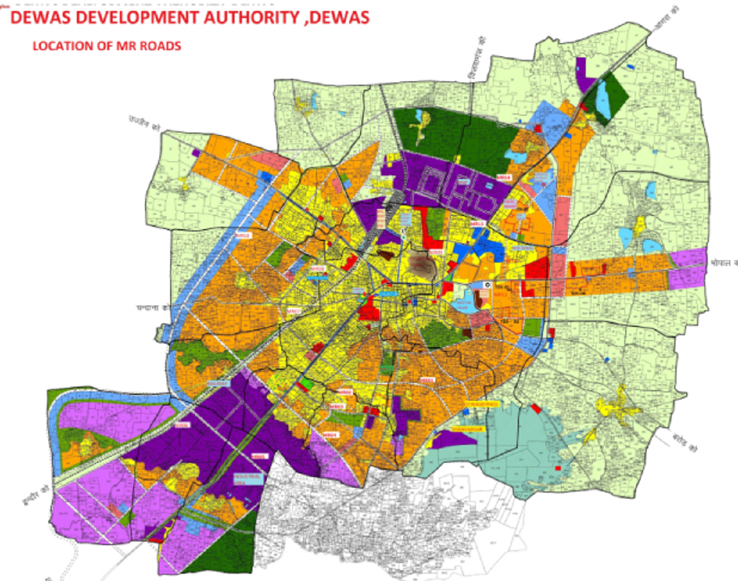
Dewas Municipal Corporation, Madhya Pradesh
City at a glance
Census 2011 population 289550, Current Projected population 325505
Household 58816
City wards 45
Divided into four Zones
Covered under AMRUT scheme
Ranked 10th in SS 2019, 3 star city and ranked 1st in SmSC 2022

Slide 4







Dewas Municipal Corporation, Madhya Pradesh
Status of Sanitation Infrastructure – Nov 2020
03 Functional STPs
78% coverage with sewer system (46406 HHs)
Co-treatment Facility of Faecal Sludge at one STP
16 Community Toilets
11 Public Toilets
28 Public Urinals
4 desludging vehicles available

Slide 5
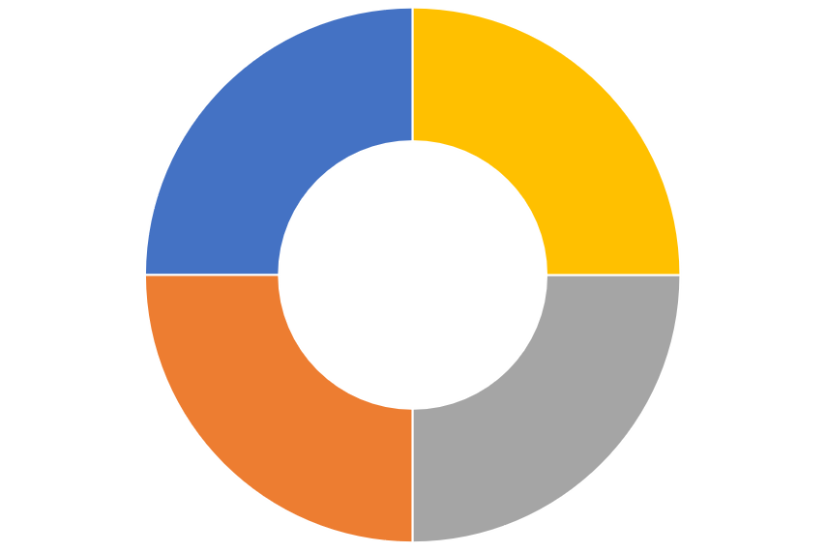
Dewas Municipal Corporation, Madhya Pradesh
Approach adopted for improving sanitation
Strengthen Institutional Set-up
Increase in Skilled Manpower, Machinery & Equipment
4-pronged approach
Capacity Building of Existing Safaimitra and Welfare
Improvement in Ecosystem parameters

Slide 6




Dewas Municipal Corporation, Madhya Pradesh
Institutional Set-up
Specific measures taken for SafaiMitra Surksha
Activated tollfree helpline for grievance redressal
Provided alternate options for citizens – My Dewas App
Setting up Emergency Sanitation Response Unit (ESRU)
Intensive IEC in each ward on septic tank desludging

Slide 7








Dewas Municipal Corporation, Madhya Pradesh
Increasing Skilled Manpower, Machines & Equipment
Engagement of Skilled Manpower
Procurement of Machines & Equipment
Ensured availability of 2 quality assurance engineer
Appointment of 3 technical supervisor for sewer cleaning team
Increased septic tank desludging team
Inducted Sewer Entry Professionals for ESRU team.
Hydrovac sets
Sewer inspection camera apparatus
Hydro jetting machines
Two septic tank desludging vehicles (Under NSKDFC)

Slide 8
Dewas Municipal Corporation, Madhya Pradesh
Capacity Building & SafaiMitra Welfare
01
02
03
04
05
Trainings
Intégration
Linkages
Safety
Healthy Life
Conducted
two trainings for Liquid Waste Management Team
Integration of Informal Workers with Sewerage Maintenance agency
Two
Loan
linkages with NSKFDC
Advanced PPE kits were provided to Sewer Commandos
Biannual
health
check up

Slide 9


Ecosystem Improvement
Sustainability
Awareness
Infrastructure
Fixed user charges for
septic
desludging service
Emphasis on mandatorily desludging of septic tanks in every 3 years
.
100% Sewage/Septage capacity matching through 03 STPs
.
Dewas Municipal Corporation, Madhya Pradesh

Slide 10
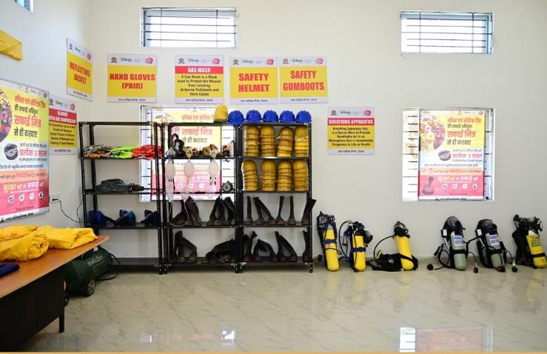
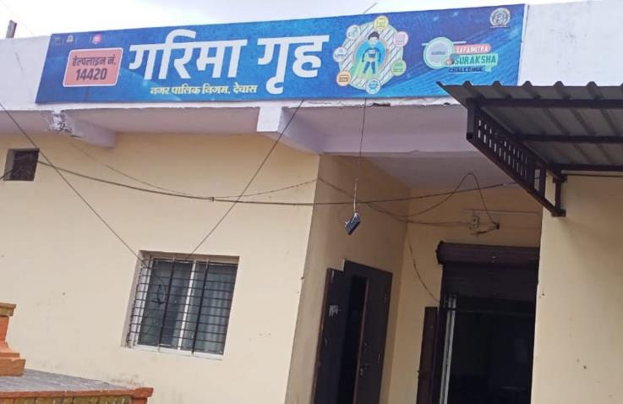
Innovations
Established “Workstations” for Liquid Waste Management Team
Garima Grah – especially designed for women sanitary workers
Future Plan
Procure low-cost Grab Bucket for sewer cleaning
Ensure more Loan linkages with NSKDFC scheme
Dewas Municipal Corporation, Madhya Pradesh

Slide 11

Thank You

